Slide 1
E-COMMERCE (ECM-133)
BIT (Third Semester) – Texas College

Slide 2
TECHNOLOGY INFRASTRUCTURE FOR E-COMMERCE
UNIT II

Slide 3
UNIT II TECHNOLOGY INFRASTRUCTURE FOR E-COMMERCE
CHAPTER 3: INTERNET, WEB, AND MOBILE PLATFORM
CHAPTER 4 : BUILDING AN E-COMMERCE PRESENCE: WEB SITES, MOBILE SITES, AND APPS
CHAPTER 5 : E-COMMERCE SECURITY AND PAYMENT SYSTEMS

Slide 4
INTERNET : KEY TECHNOLOGY CONCEPTS
Internet is a network that uses the IP addressing scheme, supports the Transmission Control Protocol (TCP), and makes services available to users much like a telephone system makes voice and data services available to the public
Behind this definition are three extremely important concepts that are the basis for understanding the Internet: packet switching, the TCP/IP communications protocol, and client/server computing. Although the Internet has evolved and changed dramatically in the last 30 years, these three concepts are at the core of the way the Internet functions today and are the foundation for the Internet of the future

Slide 5
INTERNET : KEY TECHNOLOGY CONCEPTS : PACKET SWITCHING
Packet switching is a method of slicing digital messages into discrete units called packets, sending the packets along different communication paths as they become available, and then reassembling the packets once they arrive at their destination

Slide 6
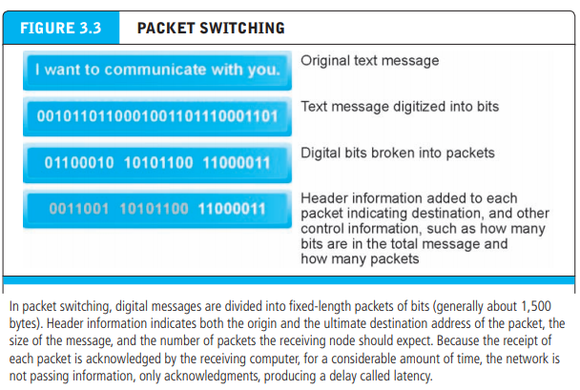
INTERNET : KEY TECHNOLOGY CONCEPTS : PACKET SWITCHING

Slide 7
INTERNET : KEY TECHNOLOGY CONCEPTS : TRANSMISSION CONTROL PROTOCOL/INTERNET PROTOCOL (TCP/IP)
While packet switching was an enormous advance in communications capacity, there was no universally agreed-upon method for breaking up digital messages into packets, routing them to the proper address, and then reassembling them into a coherent message. This was like having a system for producing stamps but no postal system (a series of post offices and a set of addresses). The answer was to develop a protocol (a set of rules and standards for data transfer) to govern the formatting, ordering, compressing, and error-checking of messages, as well as specify the speed of transmission and means by which devices on the network will indicate they have stopped sending and/or receiving messages.
Transmission Control Protocol/Internet Protocol (TCP/IP) has become the core communications protocol for the Internet (Cerf and Kahn, 1974). TCP establishes the connections among sending and receiving Web computers, and makes sure that packets sent by one computer are received in the same sequence by the other, without any packets missing. IP provides the Internet’s addressing scheme and is responsible for the actual delivery of the packets

Slide 8
INTERNET : KEY TECHNOLOGY CONCEPTS : IP ADDRESSES
The IP addressing scheme answers the question “How can billions of computers attached to the Internet communicate with one another?” The answer is that every computer connected to the Internet must be assigned an address—otherwise it cannot send or receive TCP packets. For instance, when you sign onto the Internet using a dial-up, DSL, or cable modem, your computer is assigned a temporary address by your Internet Service Provider. Most corporate and university computers attached to a local area network have a permanent IP address.

Slide 9
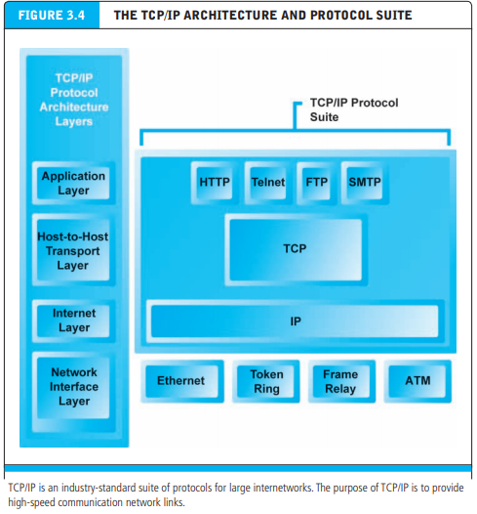
INTERNET : KEY TECHNOLOGY CONCEPTS : IP ADDRESSES

Slide 10
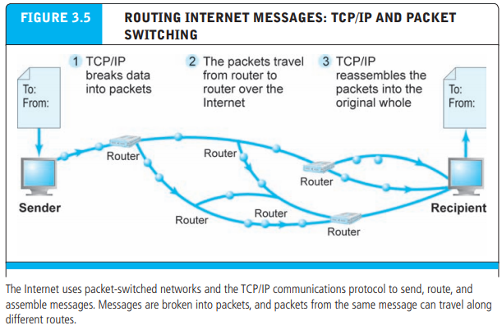
INTERNET : KEY TECHNOLOGY CONCEPTS : IP ADDRESSES

Slide 11
INTERNET : KEY TECHNOLOGY CONCEPTS : DOMAIN NAMES, DNS, AND URLS
Most people cannot remember 32-bit numbers. An IP address can be represented by a natural language convention called a domain name. The Domain Name System (DNS) allows expressions such as Cnet.com to stand for a numeric IP address (cnet. com’s numeric IP is 216.239.113.101).3 A Uniform Resource Locator (URL), which is the address used by a Web browser to identify the location of content on the Web, also uses a domain name as part of the URL. A typical URL contains the protocol to be used when accessing the address, followed by its location.

Slide 12
INTERNET : KEY TECHNOLOGY CONCEPTS : DOMAIN NAMES, DNS, AND URLS
For instance, the URL http://www.azimuth-interactive.com/flash_test refers to the IP address 208.148.84.1 with the domain name “azimuth-interactive.com” and the protocol being used to access the address, HTTP. A resource called “flash_test” is located on the server directory path /flash_test

Slide 13
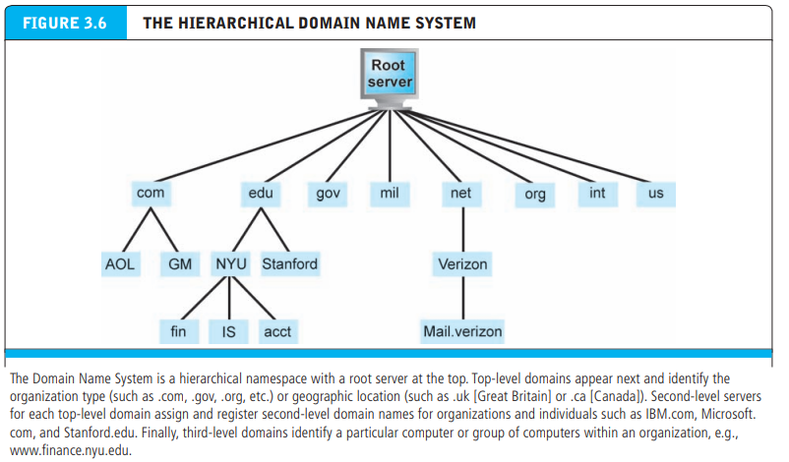
INTERNET : KEY TECHNOLOGY CONCEPTS : DOMAIN NAMES, DNS, AND URLS

Slide 14
INTERNET : KEY TECHNOLOGY CONCEPTS : CLIENT/SERVER COMPUTING
While packet switching exploded the available communications capacity and TCP/ IP provided the communications rules and regulations, it took a revolution in computing to bring about today’s Internet and the Web. That revolution is called client/server computing and without it, the Web—in all its richness—would not exist. Client/server computing is a model of computing in which powerful personal computers and other Internet devices called clients are connected in a network to one or more server computers.
These clients are sufficiently powerful to accomplish complex tasks such as displaying rich graphics, storing large files, and processing graphics and sound files, all on a local desktop or handheld device. Servers are networked computers dedicated to common functions that the client computers on the network need, such as file storage, software applications, utility programs that provide Web connections, and printers

Slide 15
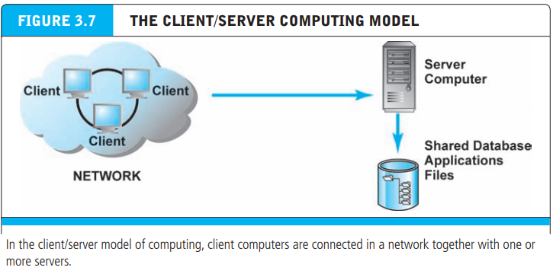
INTERNET : KEY TECHNOLOGY CONCEPTS : CLIENT/SERVER COMPUTING

Slide 16
INTERNET : KEY TECHNOLOGY CONCEPTS : THE INTERNET “CLOUD COMPUTING” MODEL: SOFTWARE AND HARDWARE AS A SERVICE
Cloud computing refers to a model of computing in which firms and individuals obtain computing power and software applications over the Internet, rather than purchasing the hardware and software and installing it on their own computers. Currently, cloud computing is the fastest growing form of computing

Slide 17
INTERNET : KEY TECHNOLOGY CONCEPTS : THE INTERNET “CLOUD COMPUTING” MODEL: SOFTWARE AND HARDWARE AS A SERVICE
Hardware firms such as IBM, HP, and Dell have built very large, scalable cloud computing centers that provide computing power, data storage, and high-speed Internet connections to firms that rely on the Internet for business software applications. Amazon, the Internet's largest retailer, is also one of the largest providers of cloud infrastructure and software services.
Software firms such as Google, Microsoft, SAP, Oracle, and Salesforce.com sell software applications that are Internet-based. Instead of software as a product, in the cloud computing model, software is a service provided over the Internet

Slide 18
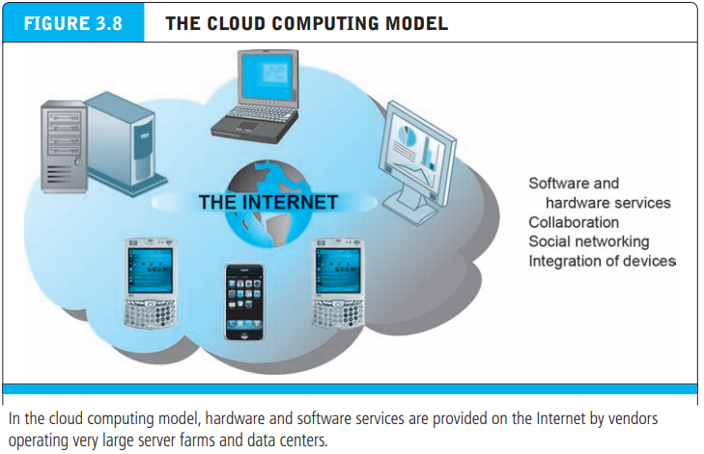
INTERNET : KEY TECHNOLOGY CONCEPTS : THE INTERNET “CLOUD COMPUTING” MODEL: SOFTWARE AND HARDWARE AS A SERVICE

Slide 19
INTERNET : KEY TECHNOLOGY CONCEPTS : NEW CLIENT: MOBILE PLATFORM
There’s a new client in town. In a few years, the primary means of accessing worldwide will be through highly portable smartphones and tablet computers, and not traditional desktop or laptop PCs. This means that the primary platform for e-commerce products and services will also change to a mobile platform
The change in hardware has reached a tipping point. The form factor of PCs has changed from desktops to laptops and tablet computers such as the iPad
Tablets are lighter, do not require a complex operating system, and rely on the Internet cloud to provide processing and storage.

Slide 20
INTERNET : KEY TECHNOLOGY CONCEPTS : NEW CLIENT: MOBILE PLATFORM
Smartphones are a disruptive technology that radically alters the personal computing and e-commerce landscape
Smartphones involve a major shift in computer processors and software that is disrupting the 40-year dual monopolies established by Intel and Microsoft, whose chips, operating systems, and software applications have dominated the PC market since 1982
The mobile platform has profound implications for e-commerce because it influences how, where, and when consumers shop and buy

Slide 21
INTERNET : KEY TECHNOLOGY CONCEPTS : OTHER INTERNET PROTOCOLS AND UTILITY PROGRAMS
There are many other Internet protocols and utility programs that provide services to users in the form of Internet applications that run on Internet clients and servers. They are not owned by any organization, but they are services that have been developed over many years and made available to all Internet users
HyperText Transfer Protocol (HTTP) is the Internet protocol used to transfer Web pages. HTTP was developed by the World Wide Web Consortium (W3C) and the Internet Engineering Task Force (IETF). HTTP runs in the Application Layer of the TCP/IP model

Slide 22
INTERNET : KEY TECHNOLOGY CONCEPTS : OTHER INTERNET PROTOCOLS AND UTILITY PROGRAMS
Simple Mail Transfer Protocol (SMTP) is the Internet protocol used to send e-mail to a server. SMTP is a relatively simple, text-based protocol that was developed in the early 1980s. SMTP handles only the sending of e-mail. To retrieve e-mail from a server, the client computer uses either Post Office Protocol 3 (POP3) or Internet Message Access Protocol (IMAP).
File Transfer Protocol (FTP) is one of the original Internet services. FTP runs in TCP/IP’s Application Layer and permits users to transfer files from a server to their client computer, and vice versa
Telnet is a network protocol that also runs in TCP/IP’s Application Layer and is used to allow remote login on another computer

Slide 23
INTERNET : KEY TECHNOLOGY CONCEPTS : OTHER INTERNET PROTOCOLS AND UTILITY PROGRAMS
Secure Sockets Layer (SSL)/Transport Layer Security (TLS) are protocols that operate between the Transport and Application Layers of TCP/IP and secure communications between the client and the server. SSL/TLS helps secure e-commerce communications and payments through a variety of techniques, such as message encryption and digital signatures
File Transfer Protocol (FTP) is one of the original Internet services. FTP runs in TCP/IP’s Application Layer and permits users to transfer files from a server to their client computer, and vice versa
Telnet is a network protocol that also runs in TCP/IP’s Application Layer and is used to allow remote login on another computer

Slide 24
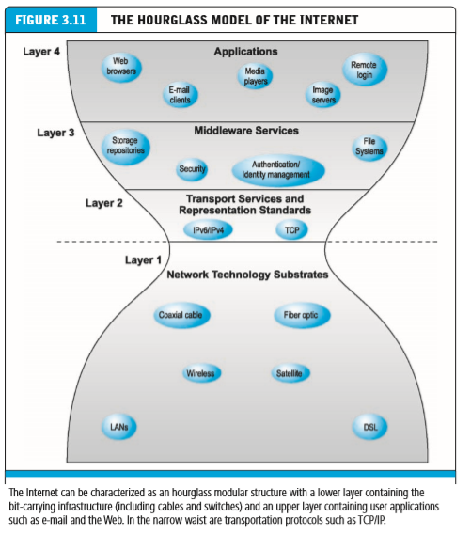
INTERNET TODAY

Slide 25
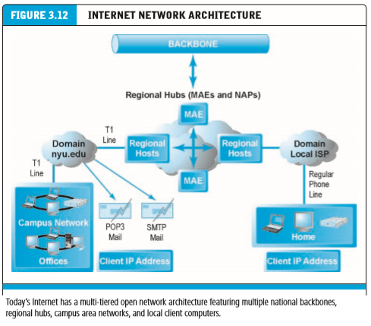
INTERNET TODAY
Backbone high-bandwidth fiber-optic cable that transports data across the Internet
Internet exchange Point (ixP) hub where the backbone intersects with local and regional networks and where backbone owners connect with one another
Network Access Points (NAPs)
Metropolitan Area Exchanges (MAEs)
Campus Area Network (can) generally, a local area network operating within a single organization that leases access to the Web directly from regional and national carriers

Slide 26
INTERNET TODAY
Internet Service Provider (ISP) firm that provides the lowest level of service in the multi-tiered Internet architecture by leasing Internet access to home owners, small businesses, and some large institutions. ISPs are retail providers. They deal with “the last mile of service” to the curb—homes and business offices. ISPs typically connect to IXPs with high-speed telephone or cable lines
Broadband refers to any communication technology that permits clients to play streaming audio and video files at acceptable speeds—generally anything above 100 Kbps
Digital Subscriber Line (DSL) delivers high-speed access through ordinary telephone lines found in homes or businesses
Cable Modem piggybacks digital access to the Internet on top of the analog video cable providing television signals to a home

Slide 27
INTERNET TODAY
Intranet
The very same Internet technologies that make it possible to operate a worldwide public network can also be used by private and government organizations as internal networks. An intranet is a TCP/IP network located within a single organization for purposes of communications and information processing
Who Governs the Internet? Analysts often claim that the Internet is governed by no one, and indeed cannot be governed, and that it is inherently above and beyond the law. There is no one single governing organization that controls activity on the Internet. Instead, there are a number of organizations that influence the system and monitor its operations

Slide 28
FUTURE INTERNET INFRASTRUCTURE
The Internet is changing as new technologies appear and new applications are developed. The next era of the Internet is being built today by private corporations, universities, and government agencies
LIMITATIONS OF CURRENT INTERNET
Much of the Internet’s current infrastructure is several decades old (equivalent to a century in Internet time). It suffers from a number of limitations, including:
Bandwidth limitations: There is insufficient capacity throughout the backbone, the metropolitan switching centers, and most importantly, the “last mile” to the house and small businesses. The result is slow peak-hour service (congestion) and a limited ability to handle high volumes of video and voice traffic

Slide 29
FUTURE INTERNET INFRASTRUCTURE
QUALITY OF SERVICE LIMITATIONS. Today’s information packets take a circuitous route to get to their final destinations. This creates the phenomenon of latency—delays in messages caused by the uneven flow of information packets through the network. In the case of e-mail, latency is not noticeable
NETWORK ARCHITECTURE LIMITATIONS. Today, a thousand requests for a single music track from a central server will result in a thousand efforts by the server to download the music to each requesting client. This slows down the network.
WIRED NETWORK. The Internet is still largely based on cables—fiber-optic and coaxial copper cables. Copper cables use a centuries-old technology, and fiber-optic cable is expensive to place underground. The wired nature of the Internet restricts mobility of users although it is changing rapidly as Wi-Fi hotspots proliferate, and cellular phone technology advances. However, cellular systems are often overloaded due to the growth in the number of smartphones

Slide 30
FUTURE INTERNET INFRASTRUCTURE
INTERNET®
Project Internet2® is an advanced networking consortium of more than 350 member institutions including universities, corporations, government research agencies, and not-forprofit networking organizations, all working in partnership to facilitate the development, deployment, and use of revolutionary Internet technologies. The broader Internet2 community includes more than 66,000 institutions across the United States and international networking partners in more than 50 countries. Internet2’s work is a continuation of the kind of cooperation among government, private, and educational organizations that created the original Internet

Slide 31
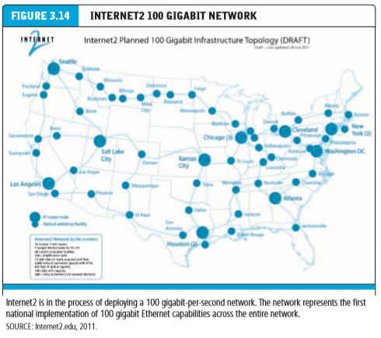
FUTURE INTERNET INFRASTRUCTURE

Slide 32
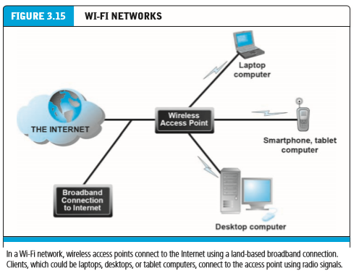
FUTURE INTERNET INFRASTRUCTURE

Slide 33
WEB
Without the Web, there would be no e-commerce. The invention of the Web brought an extraordinary expansion of digital services to millions of amateur computer users, including color text and pages, formatted text, pictures, animations, video, and sound. In short, the Web makes nearly all the rich elements of human expression needed to establish a commercial marketplace available to nontechnical computer users worldwide
HyperText Web pages can be accessed through the Internet because the Web browser software on your PC can request Web pages stored on an Internet host server using the HTTP protocol. Hypertext is a way of formatting pages with embedded links that connect documents to one another and that also link pages to other objects such as sound, video, or animation files. When you click on a graphic and a video clip plays, you have clicked on a hyperlink. For example, when you type a Web address in your browser such as http://www.sec.gov, your browser sends an HTTP request to the sec.gov server requesting the home page of sec.gov

Slide 34
WEB
When typed into a browser, a URL tells it exactly where to look for the information. For example, in the following URL:
http://www.megacorp.com/content/features/082602.html
http = the protocol used to display Web pages
www.megacorp.com = domain name
content/features = the directory path that identifies where on the domain Web server the page is stored
082602.html = the document name and its format (an HTML page)

Slide 35
WEB - MARKUP LANGUAGES
Although the most common Web page formatting language is HTML, the concept behind document formatting actually had its roots in the 1960s with the development of Generalized Markup Language (GML).
HyperText Markup Language (HTML) is a GML that is relatively easy to use. HTML provides Web page designers with a fixed set of markup “tags” that are used to format a Web page.
When these tags are inserted into a Web page, they are read by the browser and interpreted into a page display

Slide 36
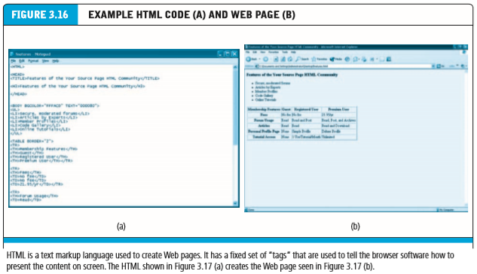
WEB - MARKUP LANGUAGES

Slide 37
WEB - MARKUP LANGUAGES
eXtensible Markup Language (XML)
XML takes Web document formatting a giant leap forward. XML is a markup language specification developed by the W3C that is similar to HTML, but has a very different purpose. Whereas the purpose of HTML is to control the “look and feel” and display of data on the Web page, XML is designed to describe data and information
The first line in the sample document is the XML declaration, which is always included; it defines the XML version of the document. In this case, the document conforms to the 1.0 specification of XML

Slide 38
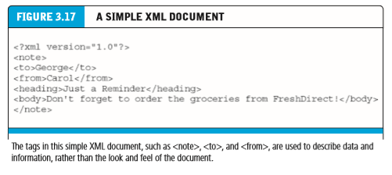
WEB - MARKUP LANGUAGES

Slide 39
WEB - MARKUP LANGUAGES
eXtensible Markup Language (XML)
XML can be used to define a database of company names in a company directory. Tags such as <Company>, <Name>, and <Specialty> can be defined for a single firm, or an entire industry. On an elementary level, XML is extraordinarily easy to learn and is very similar to HTML except that you can make up your own tags. At a deeper level, XML has a rich syntax and an enormous set of software tools, which make XML ideal for storing and communicating many types of data on the Web

Slide 40
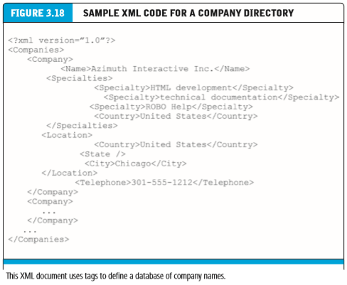
WEB - MARKUP LANGUAGES

Slide 41
WEB - WEB SERVER SOFTWARE
Web server software refers to the software that enables a computer to deliver Web pages written in HTML to client computers on a network that request this service by sending an HTTP request. The two leading brands of Web server software are Apache, which is free Web server shareware that accounts for about 52% of the market, and Microsoft’s Internet Information Services (IIS), which accounts for about 20% of the market
Aside from responding to requests for Web pages, all Web servers provide some additional basic capabilities such as the following:
Security services—These consist mainly of authentication services that verify that the person trying to access the site is authorized to do so. For Web sites that process payment transactions, the Web server also supports SSL and TLS, the protocols for transmitting and receiving information securely over the Internet. When private information such as names, phone numbers, addresses, and credit card data needs to be provided to a Web site, the Web server uses SSL to ensure that the data passing back and forth from the browser to the server is not compromised.

Slide 42
WEB - WEB SERVER SOFTWARE
FTP —This protocol allows users to transfer files to and from the server. Some sites limit file uploads to the Web server, while others restrict downloads, depending on the user’s identity.
Search engine—Just as search engine sites enable users to search the entire Web for particular documents, search engine modules within the basic Web server software package enable indexing of the site’s Web pages and content and permit easy keyword searching of the site’s content. When conducting a search, a search engine makes use of an index, which is a list of all the documents on the server. The search term is compared to the index to identify likely matches.

Slide 43
WEB - WEB SERVER SOFTWARE
Data capture—Web servers are also helpful at monitoring site traffic, capturing information on who has visited a site, how long the user stayed there, the date and time of each visit, and which specific pages on the server were accessed. This information is compiled and saved in a log file, which can then be analyzed. By analyzing a log file, a site manager can find out the total number of visitors, the average length of each visit, and the most popular destinations, or Web pages
Web Browser
A Web browser is a software program whose primary purpose is to display Web pages. Browsers also have added features, such as e-mail and newsgroups
Some popular browsers are: Internet Explorer(IE), Google Chrome, Mozilla Firefox, Safari

Slide 44
INTERNET AND WEB : FEATURE AND SERVICES
The Internet and the Web have spawned a number of powerful software applications upon which the foundations of e-commerce are built. You can think of all these as Web services, and it is interesting as you read along to compare these services to other traditional media such as television or print media. If you do, you will quickly realize the richness of the Internet.
E-MAIL : Since its earliest days, electronic mail, or e­mail, has been the most-used application of the Internet. E-mail uses a series of protocols to enable messages containing text, images, sound, and video clips to be transferred from one Internet user to another. Because of its flexibility and speed, it is now the most popular form of business communication—more popular than the phone, fax, or snail mail

Slide 45
INTERNET AND WEB : FEATURE AND SERVICES
Instant messaging (IM) allows you to send messages in real time, one line at a time, unlike e-mail. E-mail messages have a time lag of several seconds to minutes between when messages are sent and received.
Search engines identify Web pages that appear to match keywords, also called queries, entered by a user and then provide a list of the best matches (search results).

Slide 46
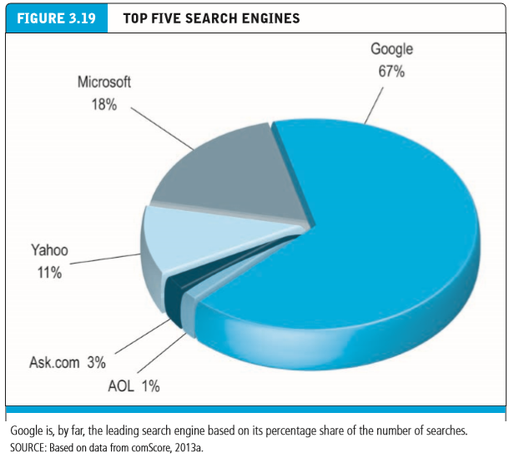
INTERNET AND WEB : FEATURE AND SERVICES

Slide 47
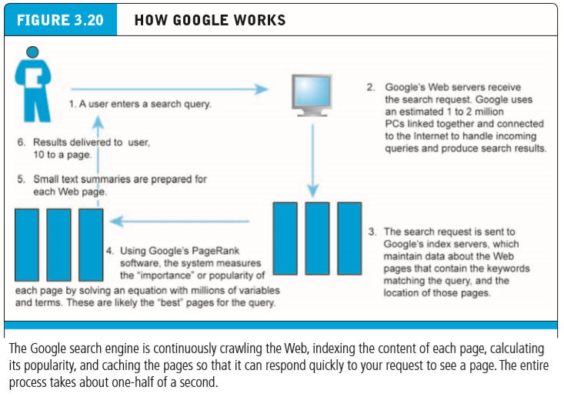
INTERNET AND WEB : FEATURE AND SERVICES

Slide 48
INTERNET AND WEB : FEATURE AND SERVICES
Streaming media enables live Web video, music, video, and other large-bandwidth files to be sent to users in a variety of ways that enable the user to play back the files. In some situations, such as live Web video, the files are broken into chunks and served by specialized video servers to users in chunks. Client software puts the chunks together and plays the video. In other situations, such as YouTube, a single large file is downloaded from a standard Web server to users who can begin playing the video before the entire file is downloaded
A cookie is a tool used by a Web site to store information about a user. When a visitor enters a Web site, the site sends a small text file (the cookie) to the user’s computer so that information from the site can be loaded more quickly on future visits.
The cookie can contain any information desired by the Web site designers, including customer number, pages visited, products examined, and other detailed information about the behavior of the consumer at the site. Cookies are useful to consumers because the Web site will recognize returning patrons and not ask them to register again

Slide 49
WEB : Web 2.0 features and services
Today’s broadband Internet infrastructure has greatly expanded the services available to users. These new capabilities have formed the basis for new business models.
Digital content and digital communications are the two areas where innovation is most rapid. Web 2.0 applications and services are “social” in nature because they support communication among individuals within groups or social networks
ONLINE SOCIAL NETWORKS
Online social networks are services that support communication within networks of friends, colleagues, and entire professions. Online social networks have developed very large worldwide audiences and form the basis for new advertising platforms and for social e-commerce

Slide 50
WEB : Web 2.0 features and services
BLOGS
A blog (originally called a weblog) is a personal Web page that typically contains a series of chronological entries (newest to oldest) by its author, and links to related Web pages. The blog may include a blogroll (a collection of links to other blogs) and trackbacks (a list of entries in other blogs that refer to a post on the first blog). Most blogs allow readers to post comments on the blog entries as well. The act of creating a blog is often referred to as “blogging.”
REALLY SIMPLE SYNDICATION(RSS)

Slide 51
WEB : Web 2.0 features and services
REALLY SIMPLE SYNDICATION(RSS)
Really Simple Syndication (RSS) is an XML format that allows users to have digital content, including text, articles, blogs, and podcast audio files, automatically sent to their computers over the Internet. An RSS aggregator software application that you install on your computer gathers material from the Web sites and blogs that you tell it to scan and brings new information from those sites to you. Sometimes this is referred to as “syndicated” content because it is distributed by news organizations and other syndicators (or distributors).
PODCASTING
A podcast is an audio presentation—such as a radio show, audio from a movie, or simply a personal audio presentation—stored as an audio file and posted to the Web. Listeners download the files from the Web and play them on their players or computers.

Slide 52
WEB : Web 2.0 features and services
WIKIS
A wiki is a Web application that allows a user to easily add and edit content on a Web page. (The term wiki derives from the “wiki wiki” (quick or fast) shuttle buses at Honolulu Airport.) Wiki software enables documents to be written collectively and collaboratively. Most wiki systems are open source, server-side systems that store content in a relational database
MUSIC AND VIDEO SERVICES
With the low-bandwidth connections of the early Internet, audio and video files were difficult to download and share, but with the huge growth in broadband connections, these files are not only commonplace but today constitute the majority of Web traffic

Slide 53
WEB : Web 2.0 features and services
INTERNET TELEPHONY
IP telephony is a general term for the technologies that use Voice over Internet Protocol (VoIP) and the Internet’s packet-switched network to transmit voice, fax, and other forms of audio communication over the Internet. VoIP can be used over a traditional handset as well as over a mobile device. VoIP avoids the long distance charges imposed by traditional phone companies
VIDEO CONFERENCING, CHATTING, AND TELEPRESENCE
Internet video conferencing is accessible to anyone with a broadband Internet connection and a Web camera (webcam). The most widely used Web conferencing suite of tools is WebEx (now owned by Cisco). VoIP companies such as Skype and ooVoo also provide more limited Web conferencing capabilities, commonly referred to as video chatting. Apple’s FaceTime is another video chatting technology available for iOS mobile devices with a forward-facing camera and Macintosh computers equipped with Apple’s version of a Webcam, called a FaceTime camera

Slide 54
WEB : MOBILE APPS OR M-COMMERCE: NEXT BIG THING
The use of mobile Internet access devices such as smartphones, iPads and other tablet computers, and laptops in e-commerce has truly exploded. Smartphone and tablet users spent the majority of their time using mobile apps rather than the mobile Web
Platforms for Mobile Application Development
There are a variety of different platforms for mobile application development including Objective-C (for iOS devices), Java (BlackBerrys and Android smartphones), and C and C++ (Windows mobile devices and some BlackBerry coding).
Mobile App Marketplaces
Once written, applications are distributed through various marketplaces. Android apps for Android-based phones are distributed through Google Play, which is controlled by Google. iPhone applications are distributed through Apple’s App Store. BlackBerry applications can be found in RIM’s App World, while Microsoft operates the Windows Phone Marketplace for Windows mobile devices. Apps can also be purchased from third-party vendors such as Amazon’s Appstore

Slide 55
UNIT II TECHNOLOGY INFRASTRUCTURE FOR E-COMMERCE
CHAPTER 4
BUILDING AN E-COMMERCE PRESENCE: WEB SITES, MOBILE SITES, AND APPS

Slide 56
B U I L D I N G A N E - C O M M E R C E P R E S E N C E : W E B S I T E S , M O B I L E S I T E S , A N D A P P S
In Chapter 3, you learned about e-commerce’s technological foundation: the Internet, Web, and the mobile platform. In this chapter, we will examine the important factors that a manager needs to consider when building an e-commerce presence. The focus will be on the managerial and business decisions you must make before you begin, and that you will continually need to make.
Although building a sophisticated e-commerce presence isn’t easy, today’s tools are much less expensive and far more powerful than they were during the early days of e-commerce. You do not have to be Amazon or eBay to create a successful Web e-commerce presence. In this chapter, we focus on both small and medium-sized businesses as well as much larger corporate entities that serve thousands of customers a day, or even an hour.

Slide 57
IMAGING YOUR E-COMMERCE PRESENCE
Before you begin to build a Web site or app of your own, there are some important questions you will need to think about and answer. The answers to these questions will drive the development and implementation of your online presence
What’s the Idea? (The Visioning Process)
Before you can plan and actually build a Web presence, you need to have a vision of what you hope to accomplish and how you hope to accomplish it. The vision includes not just a statement of mission, but also identification of the target audience, characterization of the market space, a strategic analysis, an Internet marketing matrix, and a development timeline

Slide 58
IMAGING YOUR E-COMMERCE PRESENCE
Where’s the Money: Business and Revenue Model
Once mission statement is defined, a vision, you need to start thinking about where the money will be coming from. You will need to develop a preliminary idea of your business and revenue models. You don’t need detailed revenue and cost projections at this point. Instead, you need a general idea of how your business will generate revenues
Who and Where is the Target Audience
Without a clear understanding of your target audience, you will not have a successful Web presence. There are two questions here: who is your target audience and where are they on the Web? Your target audience can be described in a number of ways: demographics, behavior patterns (lifestyle), current consumption patterns (online vs. offline purchasing), digital usage patterns, content creation preferences (blogs, social networks, sites like Pinterest), and buyer personas (profiles of your typical customer).

Slide 59
IMAGING YOUR E-COMMERCE PRESENCE
What is the ballpark? Characterize the marketplace
Features of the marketplace to focus on include the demographics of the market and how a Web presence fits into the market. In addition, you will want to know about the structure of the market: competitors and substitute products
Where’s the Content Coming From?
Static and Dynamic Contents : Static content is text and images that do not frequently change, such as product descriptions, photos, or text that you create to share with your visitors. Dynamic content is content that changes regularly, say, daily or hourly. Dynamic content can be created by you, or increasingly, by bloggers and fans of your Web site and products

Slide 60
SWOT ANALYSIS
KNOW YOURSELF: CONDUCT A SWOT ANALYSIS
A SWOT analysis is a simple but powerful method for strategizing about your business and understanding where you should focus your efforts. In a SWOT analysis you describe your strengths, weaknesses, threats, and opportunities

Slide 61
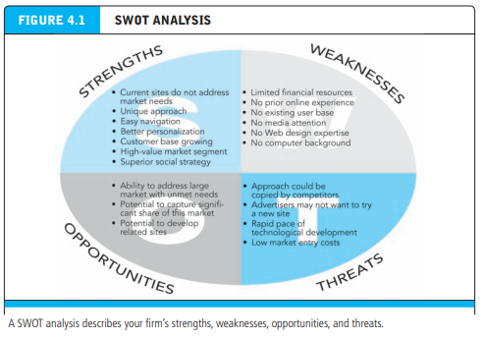
SWOT ANALYSIS

Slide 62
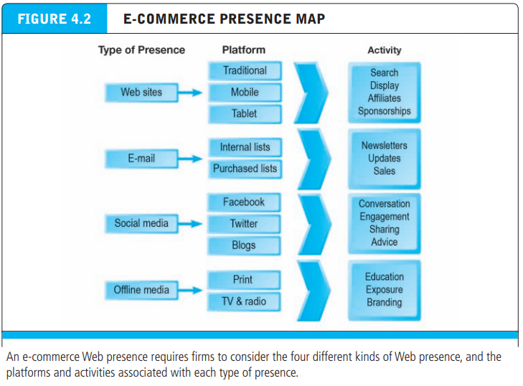
DEVELOP AN E-COMMERCE PRESENCE MAP

Slide 63
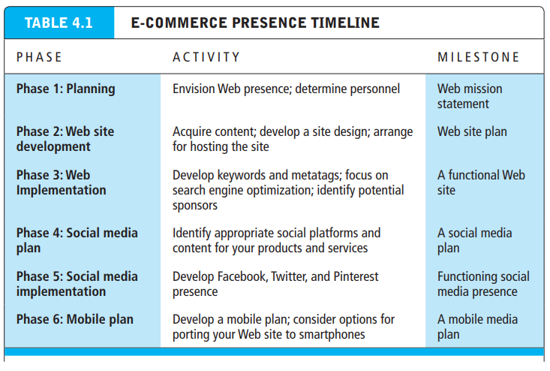
DEVELOP A TIMELINE: MILESTONES

Slide 64
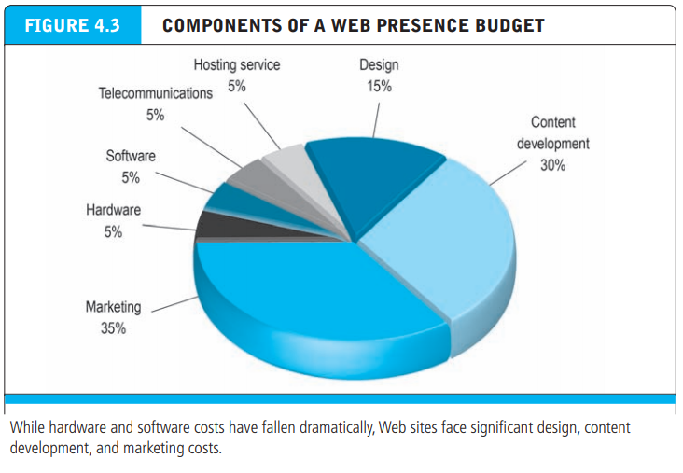
COMPONENTS OF A WEB PRESENCE BUDGET

Slide 65
BUILDING AN E-COMMERCE PRESENCE : SYSTEMATIC APPROACH
Once you have developed a vision of the Web presence you want to build, it’s time to start thinking about how to build and implement the Web presence. Building a successful e-commerce presence requires a keen understanding of business, technology, and social issues, as well as a systematic approach. E-commerce is just too important to be left totally to technologists and programmers

Slide 66
BUILDING AN E-COMMERCE PRESENCE : SYSTEMATIC APPROACH
MANAGEMENT CHALLENGES
Developing a clear understanding of your business objectives
Knowing how to choose the right technology to achieve those objectives.
The first challenge requires you to build a plan for developing your firm’s presence. The second challenge requires you to understand some of the basic elements of e-commerce infrastructure

Slide 67
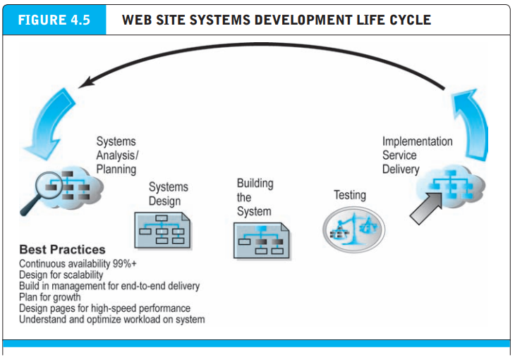
BUILDING AN E-COMMERCE PRESENCE : SYSTEMATIC APPROACH

Slide 68
BUILDING AN E-COMMERCE PRESENCE : PLANNING: THE SYSTEMS DEVELOPMENT LIFE CYCLE
Your second step in building an e-commerce Web site will be creating a plan document. In order to tackle a complex problem such as building an e-commerce site, you will have to proceed systematically through a series of steps. One methodology is the systems development life cycle. The systems development life cycle (SDLC) is a methodology for understanding the business objectives of any system and designing an appropriate solution

Slide 69
BUILDING AN E-COMMERCE PRESENCE : PLANNING: THE SYSTEMS DEVELOPMENT LIFE CYCLE
Five major steps involved in the systems development life cycle for an e-commerce site:
Systems analysis/planning : Identify the specific business objectives for the site, and then develop a list of system functionalities and information requirements
Systems design : Develop a system design specification (both logical design and physical design).
Building the system : Build the site, either by in-house personnel or by outsourcing all or part of the responsibility to outside contractors
Testing : Test the system (unit testing, system testing, and acceptance testing).
Implementation : Implement and maintain the site

Slide 70
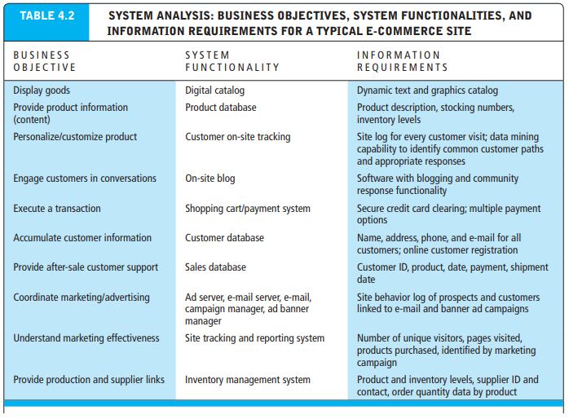
BUILDING AN E-COMMERCE PRESENCE : THE SYSTEMS DEVELOPMENT LIFE CYCLE : SYSTEM ANALYSIS

Slide 71
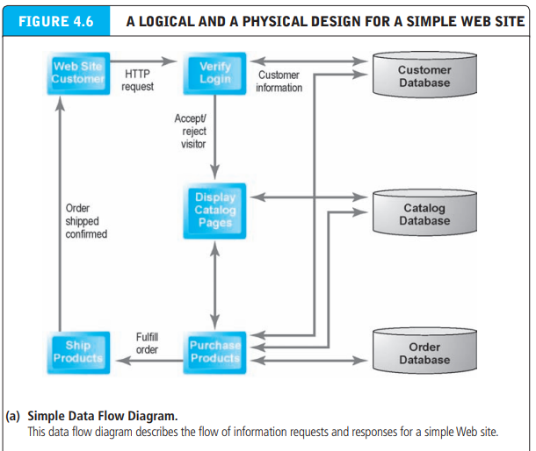
BUILDING AN E-COMMERCE PRESENCE : SYSTEM DESIGN : LOGICAL AND PHYSICAL DESIGN

Slide 72
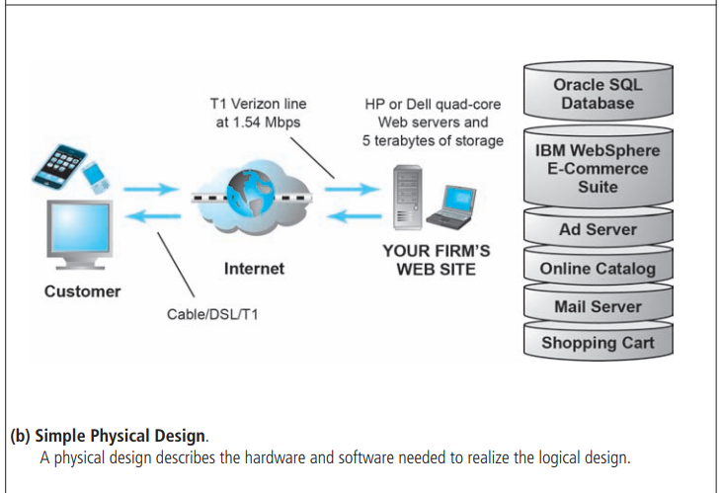
BUILDING AN E-COMMERCE PRESENCE : SYSTEM DESIGN : LOGICAL AND PHYSICAL DESIGN

Slide 73
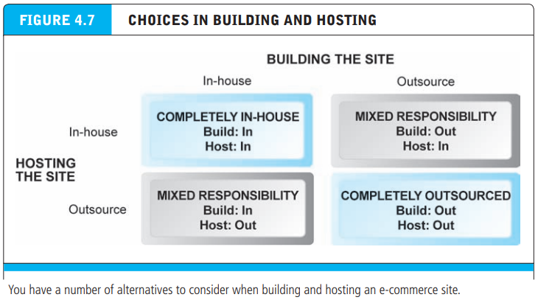
BUILDING AN E-COMMERCE PRESENCE : SYSTEM DESIGN : LOGICAL AND PHYSICAL DESIGN

Slide 74
BUILDING AN E-COMMERCE PRESENCE : TESTING AND MAINTENANCE OF THE SYSTEM
Once the system has been built and programmed, you will have to engage in a testing process. Depending on the size of the system, this could be fairly difficult and lengthy. Testing is required whether the system is outsourced or built in-house
Testing Types
Unit testing involves testing the site’s program modules one at a time
System testing involves testing the site as a whole, in the same way a typical user would when using the site
Acceptance testing requires that the firm’s key personnel and managers in marketing, production, sales, and general management actually use the system as installed on a test Internet or intranet server

Slide 75
BUILDING AN E-COMMERCE PRESENCE : TESTING AND MAINTENANCE OF THE SYSTEM
IMPLEMENTATION AND MAINTENANCE
Most people unfamiliar with systems erroneously think that once an information system is installed, the process is over. In fact, while the beginning of the process is over, the operational life of a system is just beginning. Systems break down for a variety of reasons—most of them unpredictable

Slide 76
BUILDING AN E-COMMERCE PRESENCE : CHOOSING SOFTWARE AND HARDWARE
Much of what you are able to do at an e-commerce site is a function of the software and hardware. Along with telecommunications, hardware and software constitute the infrastructure of a Web presence. As a business manager in charge of building the site, you will need to know some basic information about both
System architecture refers to the arrangement of software, machinery, and tasks in an information system needed to achieve a specific functionality (much like a home’s architecture refers to the arrangement of building materials to achieve a particular functionality).

Slide 77
BUILDING AN E-COMMERCE PRESENCE : CHOOSING SOFTWARE AND HARDWARE
Two-tier architecture e-commerce system architecture in which a Web server responds to requests for Web pages and a database server provides backend data storage
Multi-tier architecture e-commerce system architecture in which the Web server is linked to a middletier layer that typically includes a series of application servers that perform specific tasks as well as a backend layer of existing corporate systems

Slide 78
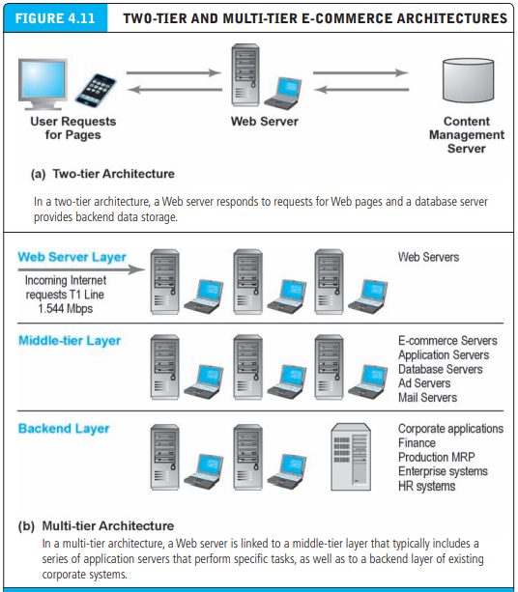
Simple Versus Multi-tiered Web Site Architecture

Slide 79
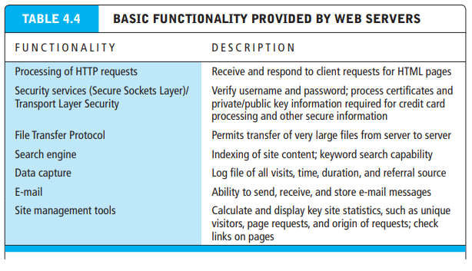
WEB SERVERS FEATURES

Slide 80
APPLICATION SERVERS
Web application servers are software programs that provide the specific business functionality required of a Web site.
The basic idea of application servers is to isolate the business applications from the details of displaying Web pages to users on the front end and the details of connecting to databases on the back end.
Application servers are a kind of middleware software that provides the glue connecting traditional corporate systems to the customer as well as all the functionality needed to conduct e-commerce

Slide 81
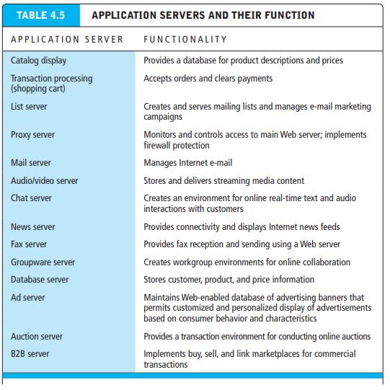
E-COMMERCE MERCHANT SERVER SOFTWARE FUNCTIONALITY

Slide 82
MERCHANT SERVER SOFTWARE PACKAGES(E-COMMERCE SUITE)
Rather than build your site from a collection of disparate software applications, it is easier, faster, and generally more cost-effective to purchase a merchant server software package (also called an e-commerce server suite)
Merchant server software/ecommerce suites offer an integrated environment that promises to provide most or all of the functionality and capabilities you will need to develop a sophisticated, customer-centric site
An important element of merchant software packages is a built-in shopping cart that can display merchandise, manage orders, and clear credit card transactions.

Slide 83
MERCHANT SERVER SOFTWARE PACKAGES(E-COMMERCE SUITE)
E-commerce suites come in three general ranges of price and functionality.
Basic packages for elementary e-commerce business applications are provided by Bizland, HyperMart, and Yahoo Merchant Solutions. PayPal can be used as a payment system on simple Web sites, and widgets can add interesting capabilities
Midrange suites include IBM WebSphere Commerce Express Edition and Commerce Server (formerly Microsoft Commerce Server)
High-end enterprise solutions for large global firms are provided by IBM WebSphere’s Commerce on Cloud, Professional, and Enterprise Editions, Oracle ATG Web Commerce, GSI Commerce, Demandware, Magento, and others

Slide 84
CHOOSING OR EVALAUTING OF AN E-COMMERCE SUITE
With all of these vendors, how do you choose the right one? Evaluating these tools and making a choice is one of the most important and uncertain decisions you will make in building an e-commerce site. The real costs are hidden—they involve training your staff to use the tools and integrating the tools into your business processes and organizational culture. The following are some of the key factors to consider:
Functionality
Support for different business models
Business process modeling tools

Slide 85
CHOOSING OR EVALAUTING OF AN E-COMMERCE SUITE
Visual site management tools and reporting
Performance and scalability
Connectivity to existing business systems
Compliance with standards
Global and multicultural capability
Local sales tax and shipping rules

Slide 86
WEB SERVICE AND OPEN SOURCE OPTIONS
While existing firms often have the financial capital to invest in commercial merchant server software suites, many small firms and start-up firms do not. They have to build their own Web sites, at least initially. There are really two options here, the key factor being how much programming experience and time you have
Open source software is software developed by a community of programmers and designers, and is free to use and modify

Slide 87
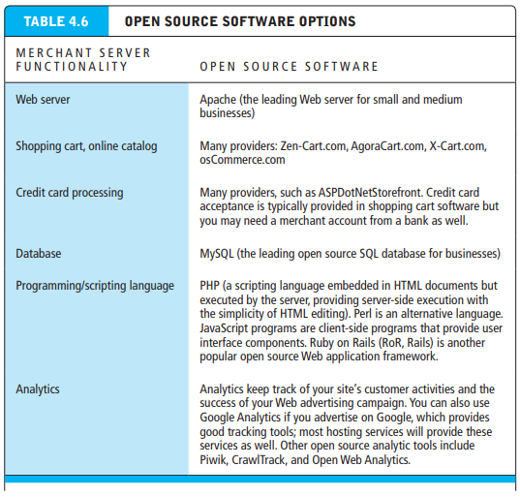
WEB SERVICE AND OPEN SOURCE OPTIONS

Slide 88
HARDWARE PLATFORM
Whether you host your own site or outsource the hosting and operation of your site, you will need to understand certain aspects of the computing hardware platform.
The hardware platform refers to all the underlying computing equipment that the system uses to achieve its e-commerce functionality.
Your objective is to have enough platform capacity to meet peak demand (avoiding an overload condition), but not so much platform that you are wasting money

Slide 89
HARDWARE PLATFORM : RIGHT SIZING PLATFORM ON DEMAND SIDE
How much computing and telecommunications capacity is enough to meet peak demand? How many hits per day can your site sustain?
To answer these questions, you will need to understand the various factors that affect the speed, capacity, and scalability of an e-commerce site
Demand on a Web site is fairly complex and depends primarily on
Type of site you are operating
The number of simultaneous users in peak periods
The nature of customer requests
The type of content

Slide 90
HARDWARE PLATFORM : RIGHT SIZING PLATFORM ON DEMAND SIDE
The required security
The number of items in inventory
The number of page requests
And the speed of legacy applications that may be needed to supply data to the Web pages are all important factors in overall demand on a Web site system

Slide 91
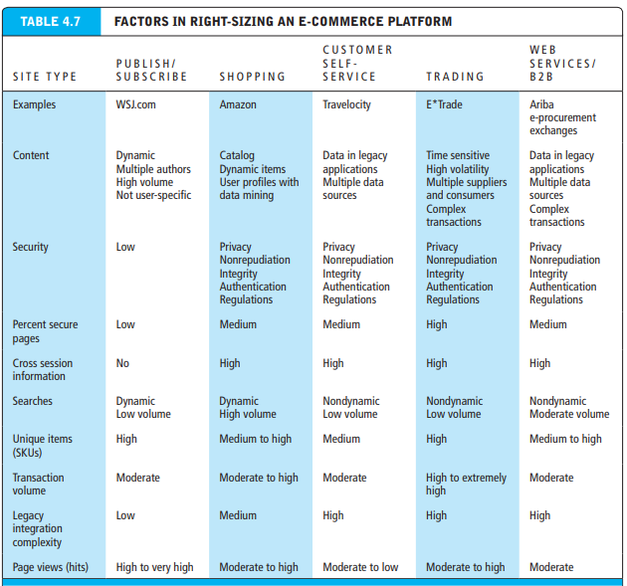
HARDWARE PLATFORM : FACTORS IN RIGHT SIZING AN E-COMMERCE PLATFORM

Slide 92
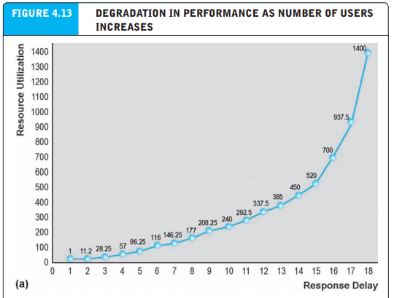
HARDWARE PLATFORM : FACTORS IN RIGHT SIZING AN E-COMMERCE PLATFORM

Slide 93
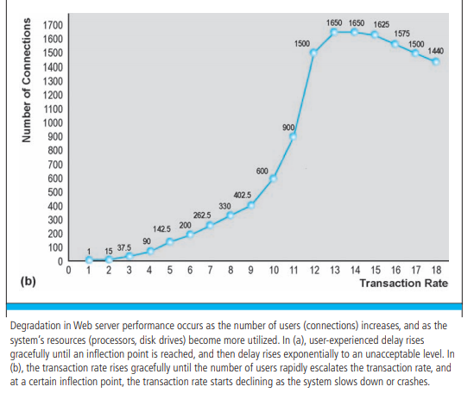
HARDWARE PLATFORM : FACTORS IN RIGHT SIZING AN E-COMMERCE PLATFORM

Slide 94
HARDWARE PLATFORM : RIGHT SIZING PLATFORM ON SUPPLY SIDE
Once you estimate the likely demand on your site, you will need to consider how to scale up your site to meet demand. We have already discussed one solution that requires very little thought: outsource the hosting of your Web site to a cloud-based service
Scalability refers to the ability of a site to increase in size as demand warrants

Slide 95
HARDWARE PLATFORM : RIGHT SIZING PLATFORM ON SUPPLY SIDE
There are three steps you can take to meet the demands for service at your site:
Scale hardware vertically : Increasing the processing power of individual components
Scale hardware horizontally: Employing multiple computers to share the workload and increase the “footprint” of the installation
And/or improve the processing architecture of the site : identifying operations with similar workloads and using dedicated, tuned servers for each type of load

Slide 96
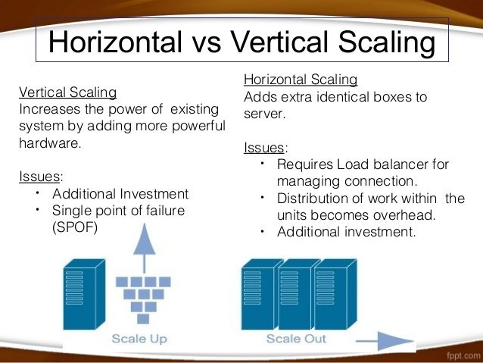
HARDWARE PLATFORM : RIGHT SIZING PLATFORM ON SUPPLY SIDE

Slide 97
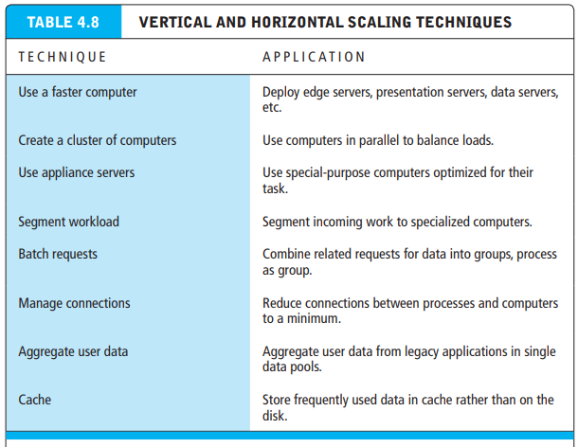
HARDWARE PLATFORM : RIGHT SIZING PLATFORM ON SUPPLY SIDE

Slide 98
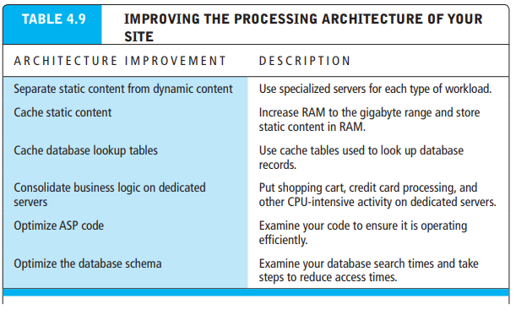
HARDWARE PLATFORM : RIGHT SIZING PLATFORM ON SUPPLY SIDE

Slide 99
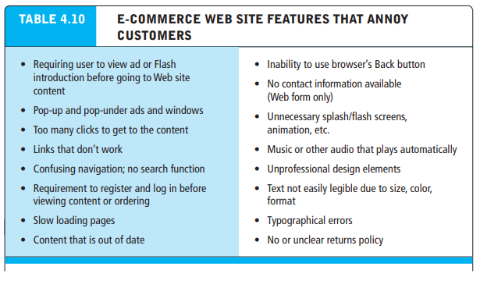
Web Site Design: Basic Business Considerations

Slide 100
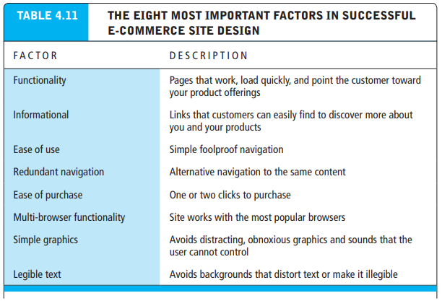
WEB SITE DESIGN: BASIC BUSINESS CONSIDERATIONS

Slide 101
TOOLS FOR WEB SITE OPTIMIZATION
A Web site is only as valuable from a business perspective as the number of people who visit. Web site optimization (as we use it here) means how to attract lots of people to your site
Metatags, titles, page contents: Search engines “crawl” your site and identify keywords as well as title pages and then index them for use in search arguments. Pepper your pages with keywords that accurately describe what you say you do in your metatag site “description” and “keywords” sections of your source code.
Identify market niches: Instead of marketing “jewelry,” be more specific, such as “Victorian jewelry,” or “1950s jewelry” to attract small, specific groups who are intensely interested in period jewelry and closer to purchasing

Slide 102
TOOLS FOR WEB SITE OPTIMIZATION
Offer expertise: White papers, industry analyses, FAQ pages, guides, and histories are excellent ways to build confidence on the part of users and to encourage them to see your Web site as the place to go for help and guidance
Get linked up: Encourage other sites to link to your site; build a blog that attracts people and who will share your URL with others and post links in the process
Buy ads: Complement your natural search optimization efforts with paid search engine keywords and ads. Choose your keywords and purchase direct exposure on Web pages
Local e-commerce: use keywords that connote your location so people can find you nearby. Town, city, and region names in your keywords can be helpful

Slide 103
TOOLS FOR INTERACTIVITY AND ACTIVE CONTENT
In addition to providing a speedy Web site, companies must also strive to have a well-designed site that encourages visitors to buy. Building in interactivity improves site effectiveness, as do personalization techniques that provide the ability to track customers while they are visiting the site. Commonly used software tools for achieving high levels of Web site interactivity and customer personalization include
Common Gateway Interface (CGI) scripts—a set of standards for communication between a browser and a program on a server that allows for interaction between the user and the server
Active Server Pages (ASP)—a Microsoft tool that also permits interaction between the browser and the server
Java applets—programs written in the Java programming language that also provide interactivity
JavaScript—used to validate user input, such as an e-mail address
ActiveX and VBScript—Microsoft’s version of Java and JavaScript, respectively
Cookies—text files stored on the user’s hard drive that provide information regarding the user and his or her past experience at a Web site

Slide 104
CHAPTER 5 : E-COMMERCE SECURITY AND PAYMENT SYSTEMS

Slide 105
E-COMMERCE SECURITY AND PAYMENT SYSTEMS
Internet and Web are increasingly vulnerable to large-scale attacks and potentially large-scale failure. Increasingly, these attacks are led by organized gangs of criminals operating globally—an unintended consequence of globalization.
Even more worrisome is the growing number of large-scale attacks that are funded, organized, and led by various nations against the Internet resources of other nations
In this chapter, we will examine e-commerce security and payment issues. First, we will identify the major security risks and their costs, and describe the variety of solutions currently available. Then, we will look at the major payment methods and consider how to achieve a secure payment environment

Slide 106
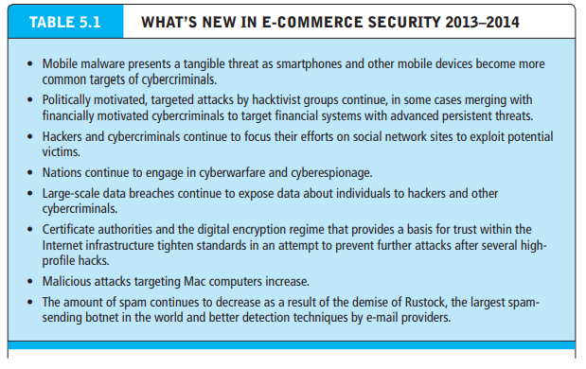
MAJOR TRENDS IN ONLINE SECURITY

Slide 107
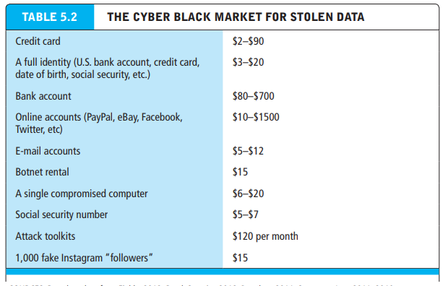
E-COMMERCE SECURITY AND PAYMENT SYSTEMS

Slide 108
WHAT IS GOOD E-COMMERCE SECURITY?
E-commerce merchants and consumers face many of the same risks as participants in traditional commerce, albeit in a new digital environment. Theft is theft, regardless of whether it is digital theft or traditional theft. Burglary, breaking and entering, embezzlement, trespass, malicious destruction, vandalism—all crimes in a traditional commercial environment—are also present in e-commerce.
However, reducing risks in e-commerce is a complex process that involves new technologies, organizational policies and procedures, and new laws and industry standards that empower law enforcement officials to investigate and prosecute offenders

Slide 109
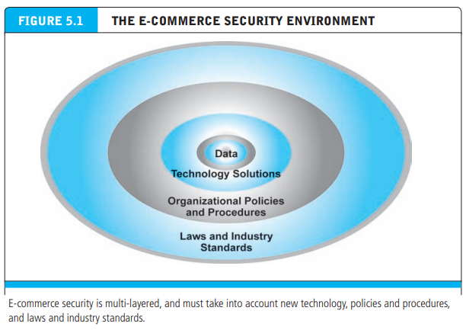
WHAT IS GOOD E-COMMERCE SECURITY?

Slide 110
DIMENSION OF E-COMMERCE SECURITY
Integrity refers to the ability to ensure that information being displayed on a Web site, or transmitted or received over the Internet, has not been altered in any way by an unauthorized party.
For example, if an unauthorized person intercepts and changes the contents of an online communication, such as by redirecting a bank wire transfer into a different account, the integrity of the message has been compromised because the communication no longer represents what the original sender intended

Slide 111
DIMENSION OF E-COMMERCE SECURITY
Nonrepudiation refers to the ability to ensure that e-commerce participants do not deny (i.e., repudiate) their online actions. For instance, the availability of free e-mail accounts with alias names makes it easy for a person to post comments or send a message and perhaps later deny doing so.
Even when a customer uses a real name and e-mail address, it is easy for that customer to order merchandise online and then later deny doing so. In most cases, because merchants typically do not obtain a physical copy of a signature, the credit card issuer will side with the customer because the merchant has no legally valid proof that the customer ordered the merchandise

Slide 112
DIMENSION OF E-COMMERCE SECURITY
Authenticity refers to the ability to identify the identity of a person or entity with whom you are dealing on the Internet. How does the customer know that the Web site operator is who it claims to be? How can the merchant be assured that the customer is really who she says she is? Someone who claims to be someone he is not is “spoofing” or misrepresenting himself.
Confidentiality refers to the ability to ensure that messages and data are available only to those who are authorized to view them. Confidentiality is sometimes confused with privacy, which refers to the ability to control the use of information a customer provides about himself or herself to an e-commerce merchant

Slide 113
DIMENSION OF E-COMMERCE SECURITY
E-commerce merchants have two concerns related to privacy. They must establish internal policies that govern their own use of customer information, and they must protect that information from illegitimate or unauthorized use. For example, if hackers break into an e-commerce site and gain access to credit card or other information, this violates not only the confidentiality of the data, but also the privacy of the individuals who supplied the information.
Availability refers to the ability to ensure that an e-commerce site continues to function as intended.

Slide 114
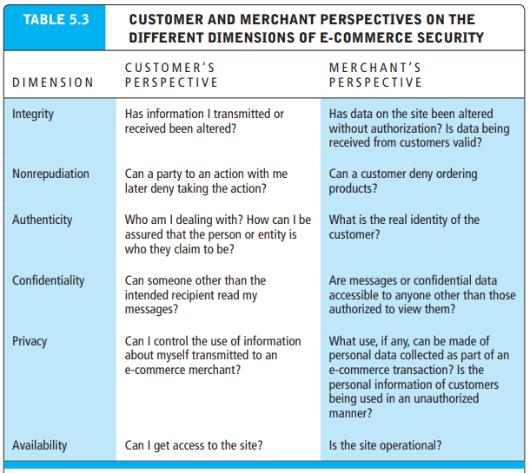
DIMENSION OF E-COMMERCE SECURITY

Slide 115
SECURITY THREATS IN E-COMMERCE ENVIRONMENT
From a technology perspective, there are three key points of vulnerability when dealing with e-commerce: the client, the server, and the communications pipeline.
Most common and most damaging forms of security threats to e-commerce consumers and site operators: malicious code, potentially unwanted programs, phishing, hacking and cyber vandalism, credit card fraud/theft, spoofing, pharming, and spam (junk) Web sites (link farms), identity fraud, Denial of Service (DoS) and DDoS attacks, sniffing, insider attacks, poorly designed server and client software, social network security issues, mobile platform security issues, and finally, cloud security issues

Slide 116
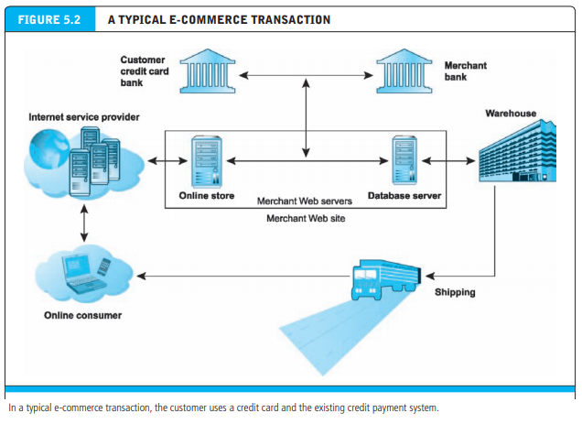
SECURITY THREATS IN E-COMMERCE ENVIRONMENT

Slide 117
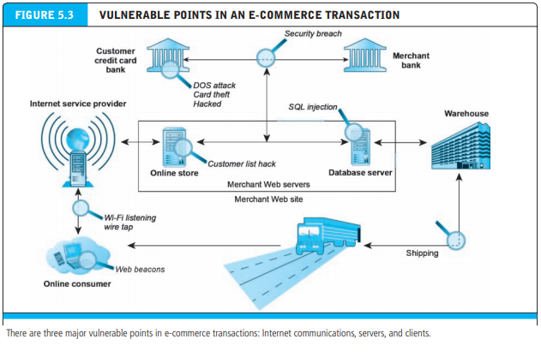
SECURITY THREATS IN E-COMMERCE ENVIRONMENT

Slide 118
SECURITY THREATS IN E-COMMERCE ENVIRONMENT
Malicious code (sometimes referred to as “malware”) includes a variety of threats such as viruses, worms, Trojan horses, ransomware, and bots. Some malicious code, sometimes referred to as an exploit, is designed to take advantage of software vulnerabilities in a computer’s operating system, Web browser, applications, or other software components.
A drive-by download is malware that comes with a downloaded file that a user intentionally or unintentionally requests. Drive-by is now one of the most common methods of infecting computers

Slide 119
SECURITY THREATS IN E-COMMERCE ENVIRONMENT
A virus is a computer program that has the ability to replicate or make copies of itself, and spread to other files. In addition to the ability to replicate, most computer viruses deliver a “payload.” The payload may be relatively benign, such as the display of a message or image, or it may be highly destructive—destroying files, reformatting the computer’s hard drive, or causing programs to run improperly.
Viruses are often combined with a worm. Instead of just spreading from file to file, a worm is designed to spread from computer to computer. A worm does not necessarily need to be activated by a user or program in order for it to replicate itself

Slide 120
SECURITY THREATS IN E-COMMERCE ENVIRONMENT
A Trojan horse appears to be benign, but then does something other than expected. The Trojan horse is not itself a virus because it does not replicate, but is often a way for viruses or other malicious code such as bots or rootkits (a program whose aim is to subvert control of the computer’s operating system) to be introduced into a computer system
Bots (short for robots) are a type of malicious code that can be covertly installed on your computer when attached to the Internet
Botnets are collections of captured computers used for malicious activities such as sending spam, stealing information from computers, and storing network traffic for later analysis

Slide 121
SECURITY THREATS IN E-COMMERCE ENVIRONMENT
In addition to malicious code, the e-commerce security environment is further challenged by potentially unwanted programs (PUPs) such as adware, browser parasites, spyware, and other applications that install themselves on a computer, such as rogue security software, typically without the user’s informed consent. Such programs are increasingly found on social network and user-generated content sites where users are fooled into downloading them
Adware is typically used to call for pop-up ads to display when the user visits certain sites. While annoying, adware is not typically used for criminal activities

Slide 122
SECURITY THREATS IN E-COMMERCE ENVIRONMENT
Spyware, on the other hand, can be used to obtain information such as a user’s keystrokes, copies of e-mail and instant messages, and even take screenshots (and thereby capture passwords or other confidential data)
Phishing, Social engineering relies on human curiosity, greed, and gullibility in order to trick people into taking an action that will result in the downloading of malware.
Phishing is any deceptive, online attempt by a third party to obtain confidential information for financial gain. Phishing attacks typically do not involve malicious code but instead rely on straightforward misrepresentation and fraud, so-called “social engineering” techniques. One of the most popular phishing attacks is the e-mail scam letter

Slide 123
HACKING, CYBERVANDALISM, HACKTIVISM, AND DATA BREACHES
A hacker is an individual who intends to gain unauthorized access to a computer system. Within the hacking community, the term cracker is typically used to denote a hacker with criminal intent, although in the public press, the terms hacker and cracker tend to be used interchangeably
A data breach occurs whenever organizations lose control over corporate information to outsiders. According to Symantec, data about more than 230 million people were exposed in 2011 as a result of data breaches. Breaches caused by hacker attacks were responsible for exposing more than 187 million identities

Slide 124
HACKING, CYBERVANDALISM, HACKTIVISM, AND DATA BREACHES
Credit Card Fraud/Theft
Theft of credit card data is one of the most feared occurrences on the Internet. Fear that credit card information will be stolen prevents users from making online purchases in many cases. Interestingly, this fear appears to be largely unfounded. Incidences of stolen credit card information are much lower than users think

Slide 125
SPOOFING, PHARMING, AND SPAM (JUNK) WEB SITES
Spoofing involves attempting to hide a true identity by using someone else’s e-mail or IP address. For instance, a spoofed e-mail will have a forged sender e-mail address designed to mislead the receiver about who sent the e-mail. IP spoofing involves the creation of TCP/IP packets that use someone else’s source IP address, indicating that the packets are coming from a trusted host.
Most current routers and firewalls can offer protection against IP spoofing. Spoofing a Web site sometimes involves pharming, automatically redirecting a Web link to an address different from the intended one, with the site masquerading as the intended destination. Links that are designed to lead to one site can be reset to send users to a totally unrelated site—one that benefits the hacker

Slide 126
IDENTITY FRAUD
Identity fraud involves the unauthorized use of another person’s personal data, such as social security, driver’s license, and/or credit card numbers, as well as user names and passwords, for illegal financial benefit. Criminals can use such data to obtain loans, purchase merchandise, or obtain other services, such as mobile phone or other utility services

Slide 127
DENIAL OF SERVICE (DOS) AND DISTRIBUTED DENIAL OF SERVICE (DDOS) ATTACKS
In a Denial of Service (DoS) attack, hackers flood a Web site with useless pings or page requests that inundate and overwhelm the site’s Web servers. Increasingly, DoS attacks involve the use of bot networks and so-called “distributed attacks” built from thousands of compromised client computers. DoS attacks typically cause a Web site to shut down, making it impossible for users to access the site
A Distributed Denial of Service (DDoS) attack uses hundreds or even thousands of computers to attack the target network from numerous launch points. DoS and DDoS attacks are threats to a system’s operation because they can shut it down indefinitely

Slide 128
DENIAL OF SERVICE (DOS) AND DISTRIBUTED DENIAL OF SERVICE (DDOS) ATTACKS
Examples:
Operation Ababil
In 2012/2013, 26 or more US banks were hit with overwhelming storms of internet traffic. The attacks disrupted, or knocked completely offline, Bank of America, Capital One, Chase, CitiBank, PNC Bank and Wells Fargo etc.
Mafiaboy
In 2000, 16 year old attacker who went by the name Mafiaboy, launched one of the largest Denial of Service attacks of the time. Mafiaboys attack disrupted and even briefly knocked big name websites offline including CNN.com, amazon.com, eBay and Yahoo. Mafiaboy had broken into 50 networks and installed software called Sinkhole which directed Sinkhole to flood the targets with attack traffic.

Slide 129
SNIFFING AND INSIDER ATTACKS
A sniffer is a type of eavesdropping program that monitors information traveling over a network. When used legitimately, sniffers can help identify potential network trouble spots, but when used for criminal purposes, they can be damaging and very difficult to detect. Sniffers enable hackers to steal proprietary information from anywhere on a network, including passwords, e-mail messages, company files, and confidential reports.
We tend to think of security threats to a business as originating outside the organization. In fact, the largest financial threats to business institutions come not from robberies but from embezzlement by insiders. Bank employees steal far more money than bank robbers. The same is true for e-commerce sites. Some of the largest disruptions to service, destruction to sites, and diversion of customer credit data and personal information have come from insiders—once trusted employees

Slide 130
POORLY DESIGNED SERVER AND CLIENT SOFTWARE
Many security threats prey on poorly designed server and client software, sometimes in the operating system and sometimes in the application software, including browsers. The increase in complexity and size of software programs, coupled with demands for timely delivery to markets, has contributed to an increase in software flaws or vulnerabilities that hackers can exploit.
For instance, SQL injection attacks take advantage of vulnerabilities in poorly coded Web application software that fails to properly validate or filter data entered by a user on a Web page to introduce malicious program code into a company’s systems and networks

Slide 131
SOCIAL NETWORK SECURITY ISSUES
Social networks like Facebook, Twitter, LinkedIn, Pinterest, and Tumblr provide a rich and rewarding environment for hackers. Viruses, site takeovers, identity fraud, malware-loaded apps, click hijacking, phishing, and spam are all found on social networks (US-CERT, 2011).
For instance, the Ramnit worm stole account information from more than 45,000 Facebook users in 2012.
Also in 2012, LinkedIn revealed that Russian hackers had obtained almost 6.5 million user passwords and posted them online and Twitter was hit by a widespread spam attack involving malicious tweets

Slide 132
MOBILE PLATFORM SECURITY ISSUES
The explosion in mobile devices has broadened opportunities for hackers. Mobile users are filling their devices with personal and financial information, and using them to conduct an increasing number of transactions, from retail purchases to mobile banking, making them excellent targets for hackers. In general, mobile devices face all the same risks as any Internet device as well as some new risks associated with wireless network security.
For instance, public Wi-Fi networks that are not secured are very susceptible to hacking

Slide 133
CLOUD SECURITY ISSUES
The move of so many Internet services into the cloud also raises security risks. From an infrastructure standpoint, DDoS attacks threaten the availability of cloud services on which more and more companies are relying. Safeguarding data being maintained in a cloud environment is also a major concern
For example, researchers identified several ways data could be accessed without authorization on Dropbox, which offers a popular cloud file-sharing service. Dropbox has also experienced several security snafus, including leaving all of its users’ files publicly accessible for four hours in June 2011 due to a software bug, the discovery of a security hole in its iOS app that allowed anyone with physical access to the phone to copy login credentials, and the theft of usernames and passwords in August 2012

Slide 134
TECHNOLOGY SOLUTIONS
At first glance, it might seem like there is not much that can be done about the onslaught of security breaches on the Internet. Reviewing the security threats in the previous section, it is clear that the threats to e-commerce are very real, potentially devastating for individuals, businesses, and entire nations, and likely to be increasing in intensity along with the growth in e-commerce.
But in fact a great deal of progress has been made by private security firms, corporate and home users, network administrators, technology firms, and government agencies

Slide 135
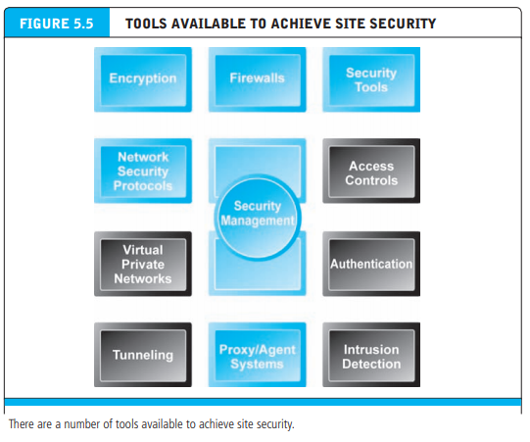
TECHNOLOGY SOLUTIONS

Slide 136
PROTECTING INTERNET COMMUNICATIONS
Because e-commerce transactions must flow over the public Internet, and therefore involve thousands of routers and servers through which the transaction packets flow, security experts believe the greatest security threats occur at the level of Internet communications.
This is very different from a private network where a dedicated communication line is established between two parties. A number of tools are available to protect the security of Internet communications, the most basic of which is message encryption.

Slide 137
ENCRYPTION
Encryption is the process of transforming plain text or data into cipher text that cannot be read by anyone other than the sender and the receiver. The purpose of encryption is (a) to secure stored information and (b) to secure information transmission. Four dimensions of encryption
Message integrity—provides assurance that the message has not been altered.
Nonrepudiation—prevents the user from denying he or she sent the message.
Authentication—provides verification of the identity of the person (or computer) sending the message
Confidentiality—gives assurance that the message was not read by others

Slide 138
ENCRYPTION
Encryption has been practiced since the earliest forms of writing and commercial transactions. Ancient Egyptian and Phoenician commercial records were encrypted using substitution and transposition ciphers. In a substitution cipher, every occurrence of a given letter is replaced systematically by another letter
Leonardo Da Vinci recorded his shop notes in reverse order, making them readable only with a mirror. The word “Hello” can be written backwards as “OLLEH.”

Slide 139
SYMMETRIC KEY ENCRYPTION
In order to decipher these messages, the receiver would have to know the secret cipher that was used to encrypt the plain text. This is called symmetric key encryption or secret key encryption. In symmetric key encryption, both the sender and the receiver use the same key to encrypt and decrypt the message. How do the sender and the receiver have the same key?
They have to send it over some communication media or exchange the key in person. Symmetric key encryption was used extensively throughout World War II and is still a part of Internet encryption

Slide 140
PUBLIC KEY ENCRYPTION
In 1976, a new way of encrypting messages called public key cryptography was invented by Whitfield Diffie and Martin Hellman. Public key cryptography solves the problem of exchanging keys. In this method, two mathematically related digital keys are used: a public key and a private key.
The private key is kept secret by the owner, and the public key is widely disseminated. Both keys can be used to encrypt and decrypt a message.
However, once the keys are used to encrypt a message, the same key cannot be used to unencrypt the message

Slide 141
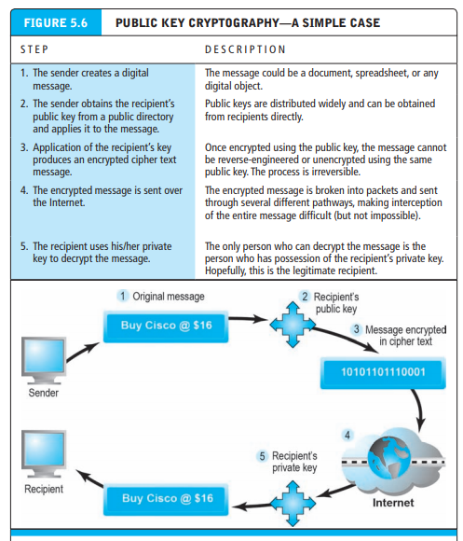
PUBLIC KEY ENCRYPTION

Slide 142
PUBLIC KEY ENCRYPTION USING DIGITAL SIGNATURES AND HASH DIGESTS
In public key encryption, some elements of security are missing. Although we can be quite sure the message was not understood or read by a third party (message confidentiality), there is no guarantee the sender really is the sender; that is, there is no authentication of the sender.
This means the sender could deny ever sending the message (repudiation). And there is no assurance the message was not altered somehow in transit.
For example, the message “Buy Cisco @ $16” could have been accidentally or intentionally altered to read “Sell Cisco @ $16.” This suggests a potential lack of integrity in the system

Slide 143
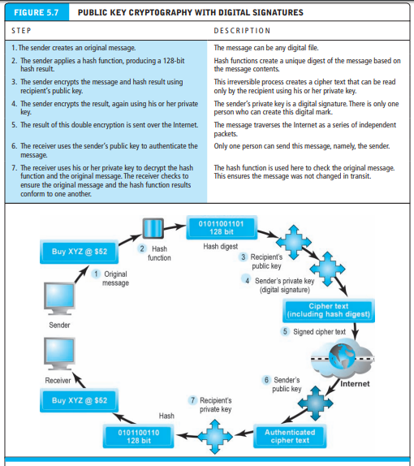
PUBLIC KEY ENCRYPTION USING DIGITAL SIGNATURES AND HASH DIGESTS

Slide 144
DIGITAL ENVELOPES
Public key encryption is computationally slow. If one used 128- or 256-bit keys to encode large documents—such as this chapter or the entire book—significant declines in transmission speeds and increases in processing time would occur.
Symmetric key encryption is computationally faster, but as we pointed out previously, it has a weakness—namely, the symmetric key must be sent to the recipient over insecure transmission lines.
One solution is to use the more efficient symmetric encryption and decryption for large documents, but public key encryption to encrypt and send the symmetric key. This technique is called using a digital envelope

Slide 145
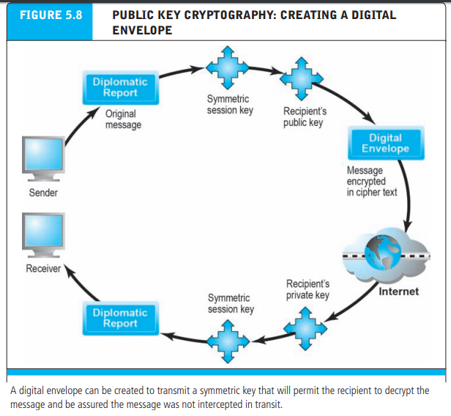
DIGITAL ENVELOPES

Slide 146
DIGITAL CERTIFICATES AND PUBLIC KEY INFRASTRUCTURE (PKI)
There are still some deficiencies in the message security regime described previously. How do we know that people and institutions are who they claim to be? Anyone can make up a private and public key combination and claim to be someone they are not. Before you place an order with an online merchant such as Amazon, you want to be sure it really is Amazon.com you have on the screen and not a spoofer masquerading as Amazon.
In the physical world, if someone asks who you are and you show a social security number, they may well ask to see a picture ID or a second form of certifiable or acceptable identification. If they really doubt who you are, they may ask for references to other authorities and actually interview these other authorities. Similarly, in the digital world, we need a way to know who people and institutions really are.

Slide 147
DIGITAL CERTIFICATES AND PUBLIC KEY INFRASTRUCTURE (PKI)
A digital certificate is a digital document issued by a trusted third-party institution known as a certification authority (CA) that contains:
Name of the subject or company, the subject’s public key,
A digital certificate serial number,
An expiration date,
An issuance date,
The digital signature of the certification authority (the name of the CA encrypted using the CA’s private key),
And other identifying information

Slide 148
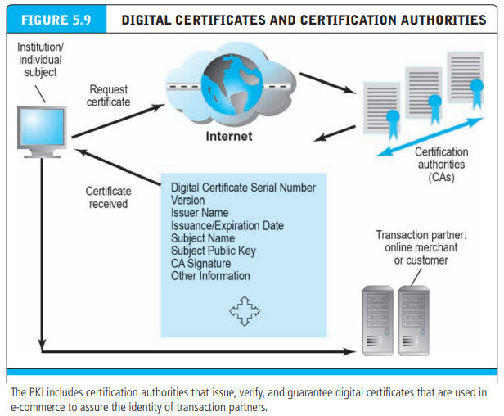
DIGITAL ENVELOPES

Slide 149
SECURING CHANNELS OF COMMUNICATION
The concepts of public key encryption are used routinely for securing channels of communication
Secure Sockets Layer (SSL) and Transport Layer Security (TLS)
The most common form of securing channels is through the Secure Sockets Layer (SSL) and Transport Layer Security (TLS) protocols. When you receive a message from a server on the Web with which you will be communicating through a secure channel, this means you will be using SSL/TLS to establish a secure negotiated session
Secure negotiated session a client-server session in which the URL of the requested document, along with the contents, contents of forms, and the cookies exchanged, are encrypted
Session key a unique symmetric encryption key chosen for a single secure session

Slide 150
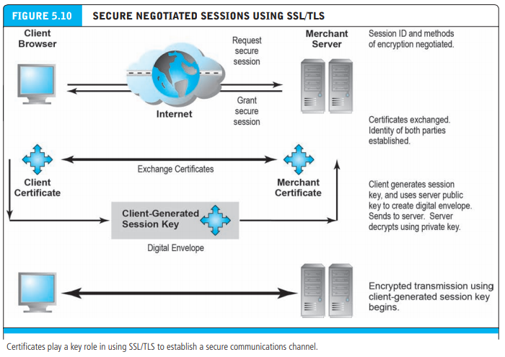
SECURING CHANNELS OF COMMUNICATION

Slide 151
SECURING CHANNELS OF COMMUNICATION
Virtual Private Networks (VPNs)
A virtual private network (VPN) allows remote users to securely access a corporation’s local area network via the Internet, using a variety of VPN protocols. VPNs use both authentication and encryption to secure information from unauthorized persons (providing confidentiality and integrity).
Authentication prevents spoofing and misrepresentation of identities. A remote user can connect to a remote private local network using a local ISP. The VPN protocols will establish the link from the client to the corporate network as if the user had dialed into the corporate network directly.
The process of connecting one protocol through another (IP) is called tunneling, because the VPN creates a private connection by adding an invisible wrapper around a message to hide its content. As the message travels through the Internet between the ISP and the corporate network, it is shielded from prying eyes by an encrypted wrapper

Slide 152
SECURING CHANNELS OF COMMUNICATION
Wireless (Wi-Fi) Networks
Accessing the Internet via a wireless (Wi-Fi) network has its own particular security issues. Early Wi-Fi networks used a security standard called Wired Equivalent Privacy (WEP) to encrypt information. WEP was very weak, and easy for hackers to crack.
A new standard, Wi-Fi Protected Access (WPA) was developed that provided a higher standard of protection, but this too soon became vulnerable to intrusion. Today, the current standard is WPA2, which uses the AES algorithm for encryption and CCMP, a more advanced authentication code protocol

Slide 153
PROTECTING NETWORKS
Once you have protected communications as well as possible, the next set of tools to consider are those that can protect your networks, as well as the servers and clients on those networks
Firewalls
Firewalls and proxy servers are intended to build a wall around your network and the attached servers and clients, just like physical-world firewalls protect you from fires for a limited period of time. Firewalls and proxy servers share some similar functions, but they are quite different.

Slide 154
PROTECTING NETWORKS
A firewall refers to either hardware or software that filters communication packets and prevents some packets from entering or exiting the network based on a security policy. The firewall controls traffic to and from servers and clients, forbidding communications from untrustworthy sources, and allowing other communications from trusted sources to proceed

Slide 155
PROTECTING NETWORKS
Proxy Servers
Proxy servers (proxies) are software servers (often a dedicated computer) that handle all communications originating from or being sent to the Internet by local clients, acting as a spokesperson or bodyguard for the organization. Proxies act primarily to limit access of internal clients to external Internet servers, although some proxy servers act as firewalls as well.
Proxy servers are sometimes called dual-home systems because they have two network interfaces. To internal computers, a proxy server is known as the gateway, while to external computers it is known as a mail server or numeric address.

Slide 156
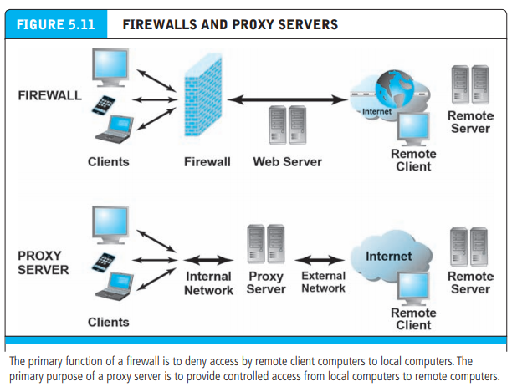
PROTECTING NETWORKS

Slide 157
PROTECTING NETWORKS
Intrusion Detection and Prevention Systems
In addition to a firewall and proxy server, an intrusion detection and/or prevention system can be installed. An intrusion detection system (IDS) examines network traffic, watching to see if it matches certain patterns or preconfigured rules indicative of an attack. If it detects suspicious activity, the IDS will set off an alarm alerting administrators and log the event in a database.
An IDS is useful for detecting malicious activity that a firewall might miss. An intrusion prevention system (IPS) has all the functionality of an IDS, with the additional ability to take steps to prevent and block suspicious activities. For instance, an IPS can terminate a session and reset a connection, block traffic from a suspicious IP address, or reconfigure firewall or router security controls.

Slide 158
PROTECTING SERVERS AND CLIENTS
Operating system features and anti-virus software can help further protect servers and clients from certain types of attacks
Operating System Security Enhancements
The most obvious way to protect servers and clients is to take advantage of automatic computer security upgrades. The Microsoft, Apple, and Linux/Unix operating systems are continuously updated to patch vulnerabilities discovered by hackers. These patches are autonomic; that is, when using these operating systems on the Internet, you are prompted and informed that operating system enhancements are available. Users can easily download these security patches for free. The most common known worms and viruses can be prevented by simply keeping your server and client operating systems and applications up to date.

Slide 159
PROTECTING SERVERS AND CLIENTS
Anti-Virus Software
The easiest and least-expensive way to prevent threats to system integrity is to install anti-virus software. Programs by McAfee, Symantec (Norton AntiVirus), and many others provide inexpensive tools to identify and eradicate the most common types of malicious code as they enter a computer, as well as destroy those already lurking on a hard drive.
Anti-virus programs can be set up so that e-mail attachments are inspected before you click on them, and the attachments are eliminated if they contain a known virus or worm. It is not enough, however, to simply install the software once. Since new viruses are developed and released every day, daily routine updates are needed in order to prevent new threats from being loaded. Some premium-level anti-virus software is updated hourly.

Slide 160
MANAGEMENT POLICIES, BUSINESS PROCEDURES, AND PUBLIC LAWS
Worldwide, in 2013, companies are expected to spend over $65 billion on security hardware, software, and services (Gartner, 2013). However, most CEOs and CIOs believe that technology is not the sole answer to managing the risk of e-commerce.
The technology provides a foundation, but in the absence of intelligent management policies, even the best technology can be easily defeated. Public laws and active enforcement of cybercrime statutes also are required to both raise the costs of illegal behavior on the Internet and guard against corporate abuse of information. Let’s consider briefly the development of management policy

Slide 161
SECURITY PLAN: MANAGEMENT POLICIES
In order to minimize security threats, e-commerce firms must develop a coherent corporate policy that takes into account the nature of the risks, the information assets that need protecting, and the procedures and technologies required to address the risk, as well as implementation and auditing mechanisms

Slide 162
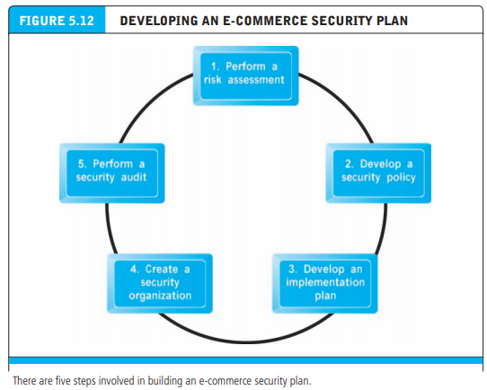
SECURITY PLAN: MANAGEMENT POLICIES

Slide 163
THE ROLE OF LAWS AND PUBLIC POLICY
The public policy environment today is very different from the early days of e-commerce. The net result is that the Internet is no longer an ungoverned, unsupervised, self-controlled technology juggernaut. Just as with financial markets in the last 70 years, there is a growing awareness that e-commerce markets work only when a powerful institutional set of laws and enforcement mechanisms are in place.

Slide 164
THE ROLE OF LAWS AND PUBLIC POLICY
These laws help ensure orderly, rational, and fair markets. This growing public policy environment is becoming just as global as e-commerce itself. Despite some spectacular internationally based attacks on U.S. e-commerce sites, the sources and persons involved in major harmful attacks have almost always been uncovered and, where possible, prosecuted

Slide 165

THE ROLE OF LAWS AND PUBLIC POLICY

Slide 166


THE ROLE OF LAWS AND PUBLIC POLICY

Slide 167
PRIVATE AND PRIVATE-PUBLIC COOPERATION EFFORTS
The good news is that e-commerce sites are not alone in their battle to achieve security on the Internet. Several organizations—some public and some private—are devoted to tracking down criminal organizations and individuals engaged in attacks against Internet and e-commerce sites.
One of the better-known private organizations is the CERT Coordination Center (formerly known as the Computer Emergency Response Team) at Carnegie Mellon University

Slide 168
PRIVATE AND PRIVATE-PUBLIC COOPERATION EFFORTS
CERT monitors and tracks online criminal activity reported to it by private corporations and government agencies that seek out its help. CERT is composed of full-time and part-time computer experts who can trace the origins of attacks against sites despite the complexity of the Internet. Its staff members also assist organizations in identifying security problems, developing solutions, and communicating with the public about widespread hacker threats.
The CERT Coordination Center also provides product assessments, reports, and training in order to improve the public’s knowledge and understanding of security threats and solutions

Slide 169

GOVERNMENT POLICIES AND CONTROLS ON ENCRYPTION SOFTWARE

Slide 170
PAYMENT SYSTEMS
Types of Payment Systems
In order to understand e-commerce payment systems, you first need to be familiar with the various types of generic payment systems. Then you will be able to clarify the different requirements that e-commerce payment systems must meet and identify the opportunities provided by e-commerce technology for developing new types of payment systems.
There are five main types of payment systems: cash, checking transfer, credit cards, stored value, and accumulating balance

Slide 171
PAYMENT SYSTEMS - TYPES
Cash, which is legal tender defined by a national authority to represent value, is the most common form of payment in terms of number of transactions. The key feature of cash is that it is instantly convertible into other forms of value without the intermediation of any other institution. For instance, free airline miles are not cash because they are not instantly convertible into other forms of value—they require intermediation by a third party (the airline) in order to be exchanged for value (an airline ticket). Private organizations sometimes create a form of private cash called scrip that can be instantly redeemed by participating organizations for goods or cash. Examples include trading stamps, “point” programs, and other forms of consumer loyalty currency

Slide 172
PAYMENT SYSTEMS - TYPES
Checking Transfer
A checking transfer, which represents funds transferred directly via a signed draft or check from a consumer’s checking account to a merchant or other individual, is the second most common form of payment in the United States in terms of number of transactions, and the most common in terms of total amount spent
Checks can be used for both small and large transactions, although typically they are not used for micropayments (less than $1)

Slide 173
PAYMENT SYSTEMS - TYPES
Credit Card
A credit card represents an account that extends credit to consumers, permits consumers to purchase items while deferring payment, and allows consumers to make payments to multiple vendors with one instrument. Credit card associations such as Visa and MasterCard are nonprofit associations that set standards for the issuing banks—such as Citibank—that actually issue the credit cards and process transactions.
Other third parties (called processing centers or clearinghouses) usually handle verification of accounts and balances. Credit card issuing banks act as financial intermediaries, minimizing the risk to transacting parties

Slide 174
PAYMENT SYSTEMS - TYPES
Stored Value
Accounts created by depositing funds into an account and from which funds are paid out or withdrawn as needed are stored value payment systems.
Stored value payment systems are similar in some respects to checking transfers—which also store funds—but do not involve writing a check.
Examples include debit cards, gift certificates, prepaid cards, and smart cards

Slide 175
PAYMENT SYSTEMS - TYPES
Accumulating Balance
Accounts that accumulate expenditures and to which consumers make periodic payments are accumulating balance payment systems. Traditional examples include utility, phone, and American Express accounts, all of which accumulate balances, usually over a specified period (typically a month), and then are paid in full at the end of the period

Slide 176
PAYMENT SYSTEMS - STAKEHOLDERS
The main stakeholders in payment systems are consumers, merchants, financial intermediaries, and government regulators. Each of these stakeholders has different preferences.
Consumers are interested primarily in low-risk, low-cost, refutable (able to be repudiated or denied), convenient, and reliable payment mechanisms. Consumers have demonstrated they will not use new payment mechanisms unless they are equally or more beneficial to them than existing systems. In general, most consumers use cash, checks, and/or credit cards.

Slide 177
PAYMENT SYSTEMS - STAKEHOLDERS
The specific payment system chosen will change depending on the transaction situation. For instance, cash may be preferred to keep certain transactions private and anonymous, but the same consumer may want a record of transaction for the purchase of a car
Merchants are interested primarily in low-risk, low-cost, irrefutable (i.e., final), secure, and reliable payment mechanisms. Merchants currently carry much of the risk of checking and credit card fraud, refutability of charges, and much of the hardware cost of verifying payments

Slide 178
PAYMENT SYSTEMS - STAKEHOLDERS
Financial intermediaries, such as banks and credit card networks, are primarily interested in secure payment systems that transfer risks and costs to consumers and merchants, while maximizing transaction fees payable to themselves. The preferred payment mechanisms for financial intermediaries are checking transfers, debit cards, and credit cards
Government regulators are interested in maintaining trust in the financial system. Regulators seek to protect against fraud and abuse in the use of payment systems; ensure that the interests of consumers and merchants are balanced against the interests of the financial intermediaries whom they regulate; and enforce information reporting laws

Slide 179
E-COMMERCE PAYMENT SYSTEMS
For the most part, existing payment mechanisms have been able to be adapted to the online environment, albeit with some significant limitations that have led to efforts to develop alternatives
In addition, new types of purchasing relationships, such as between individuals online, and new technologies, such as the development of the mobile platform, have also created both a need and an opportunity for the development of new payment systems. In this section, we provide an overview of the major e-commerce payment systems in use today

Slide 180

E-COMMERCE PAYMENT SYSTEMS

Slide 181

E-COMMERCE PAYMENT SYSTEMS

Slide 182

E-COMMERCE PAYMENT SYSTEMS

Slide 183

E-COMMERCE PAYMENT SYSTEMS - ONLINE CREDIT CARD TRANSACTIONS

Slide 184
E-COMMERCE PAYMENT SYSTEMS
Limitations of Online Credit Card Payment Systems
The administrative costs of setting up an online credit card system and becoming authorized to accept credit cards are high. Transaction costs for merchants also are significant—roughly 3.5% of the purchase plus a transaction fee of 20–30 cents per transaction, plus other setup fees.
Credit cards are not very democratic, even though they seem ubiquitous. Millions of young adults do not have credit cards, along with almost 100 million other adult Americans who cannot afford cards or who are considered poor risks because of low incomes

Slide 185
E-COMMERCE PAYMENT SYSTEMS
Alternative Online Payment Systems
The limitations of the online credit card system have opened the way for the development of a number of alternative online payment systems. Chief among them is PayPal. PayPal (purchased by eBay in 2002) enables individuals and businesses with e-mail accounts to make and receive payments up to a specified limit.
Paypal is an example of an online stored value payment system, which permits consumers to make instant, online payments to merchants and other individuals based on value stored in an online account. In 2012, PayPal processed $145 billion in payments ($48 billion of which were generated on eBay, and $97 billion elsewhere on the Web), and had 132 million active registered users

Slide 186
E-COMMERCE PAYMENT SYSTEMS
Mobile Payment Systems: Your Smartphone Wallet
The use of mobile devices as payment mechanisms is already well established in Europe, Japan, and South Korea and is now exploding in the United States, where the infrastructure to support mobile payment is finally being put in place. Mobile retail payments in the United States totalled over $20 billion in 2012 (Javelin Strategy & Research, 2012).
Near field communication (NFC) is one of the enabling technologies for mobile payment systems. Near field communication (NFC) is a set of short-range wireless technologies used to share information among devices within about 2 inches of each other (50 mm). NFC devices are either powered or passive

Slide 187
E-COMMERCE PAYMENT SYSTEMS
DIGITAL CASH AND VIRTUAL CURRENCIES
Although the terms digital cash and virtual currencies are often used synonymously, they actually refer to two separate types of alternative payment systems. Digital cash typically is based on an algorithm that generates unique authenticated tokens representing cash value that can be used “in the real world.”
Examples of digital cash include Bitcoin and Ukash. Bitcoins are encrypted numbers (sometimes referred to as cryptocurrency) that are generated by a complex algorithm using a peer-to-peer network in a process referred to as “mining,” that requires extensive computing power. Like real currency, Bitcoins have a fluctuating value tied to open-market trading

Slide 188
ELECTRONIC BILLING PRESENTMENT AND PAYMENT
Electronic billing presentment and payment (EBPP) systems are systems that enable the online delivery and payment of monthly bills. EBPP services allow consumers to view bills electronically and pay them through electronic funds transfers from bank or credit card accounts. More and more companies are choosing to issue statements and bills electronically, rather than mailing out paper versions.
But even those businesses that do mail paper bills are increasingly offering online bill payment as an option to customers, allowing them to immediately transfer funds from a bank or credit card account to pay a bill somewhere else

Slide 189
EBPP BUSINESS MODELS
There are two main competing business models in the EBPP marketspace: biller-direct and consolidator.
The biller-direct system was originally created by utility companies that send millions of bills each month. Their purpose is to make it easier for their customers to pay their utility bills routinely online. Today, telephone and credit card companies also frequently offer this service, as well as a number of individual stores. Companies implementing a biller-direct system can either develop their own system in-house (usually only an option for the very largest companies), install a system acquired from a third-party EBPP software vendor, use a third-party EBPP service bureau

Slide 190
EBPP BUSINESS MODELS
In the consolidator model, a third party, such as a financial institution or a focused portal such as Intuit’s Paytrust.com, Fiserv’s MyCheckFree, Pageonce, and others, aggregates all bills for consumers and ideally permits one-stop bill payment (pay anyone). Currently, financial institutions have been more successful than portals in attracting online bill payers. The consolidator model faces several challenges. For billers, using the consolidator model means an increased time lag between billing and payment, and also inserts an intermediary between the company and its customer.

Slide 191

EBPP BUSINESS MODELS

